Slide 1
Big Data, AI, Machine Learning, Investment and Algo Trading
Ken Liu

Slide 2






My Background
Study Computer Science
iBanks Algo trade technologist
Startup on Quant Trading, Big Data and AI
Email: wkliu_x@yahoo.com
LinkedIn: https://www.linkedin.com/in/ken-liu-76b11575/

Slide 3
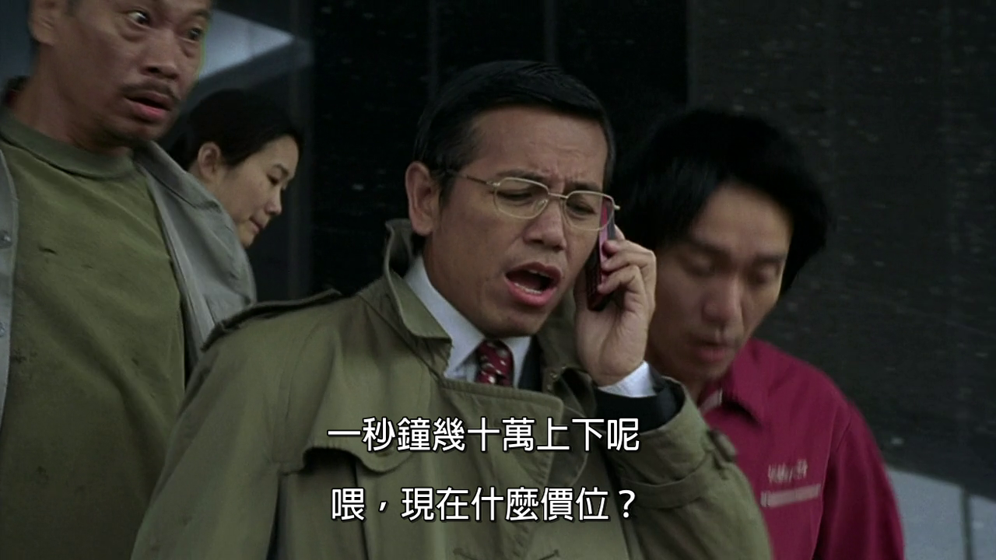
My Work
Sub-header/text/chart/table
“In one second, my portfolio values can go up/down in tens of thousands dollars”

Slide 4
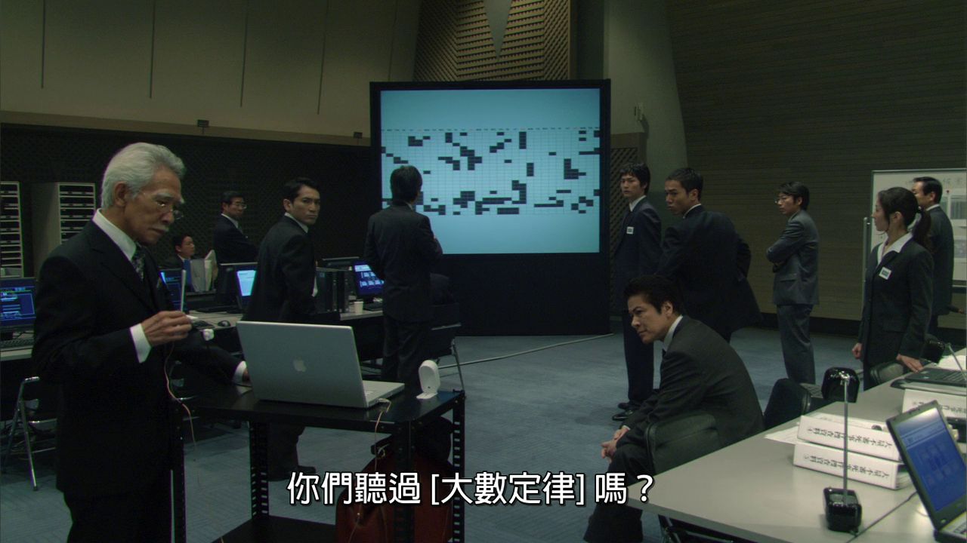
My Work
“Have you heard of Law of Big Numbers”
“results obtained from a large number of trials should be close to the expected value”

Slide 5
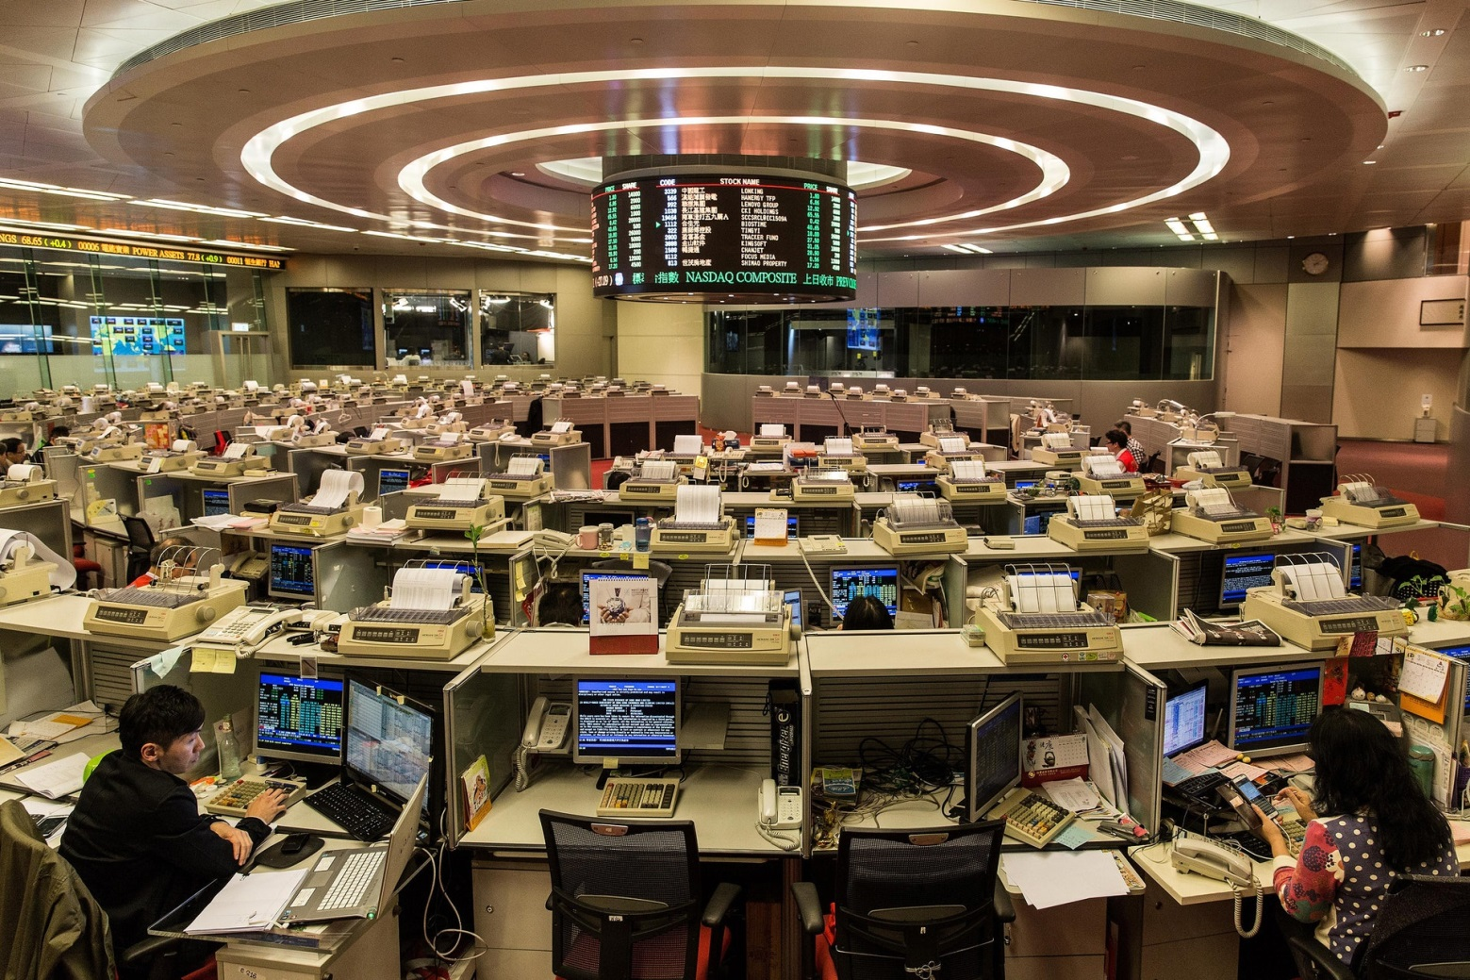
History of trading
2 April 1986 | First day of trading in the Hall
1 November 1993 | Electronic trading introduced
25 January 1996 | Off-floor trading introduced
23 October 2000 | Online trading enabled
27 October 2017 | Last day of trading in the Hall

Slide 6
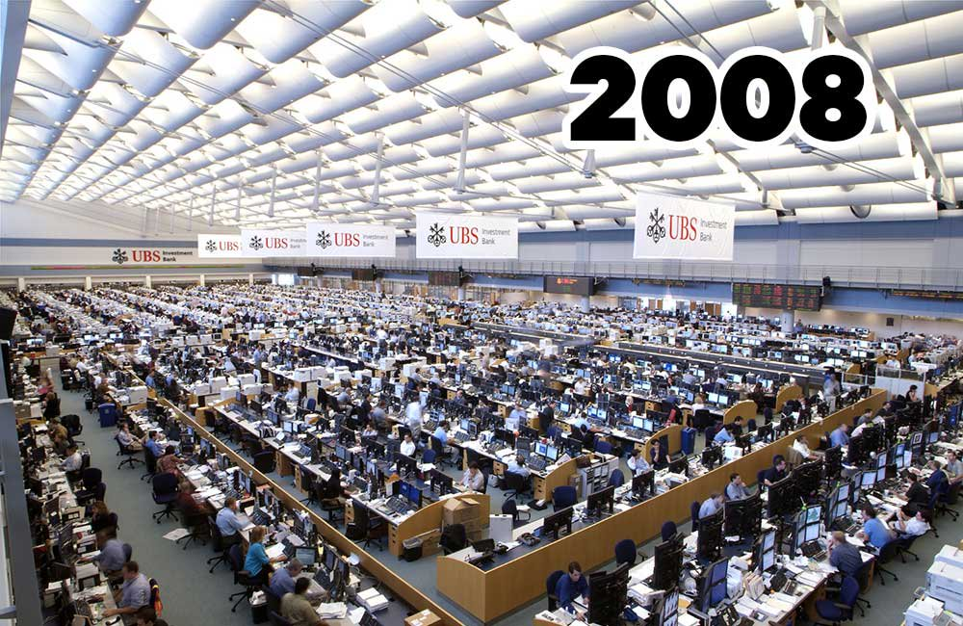
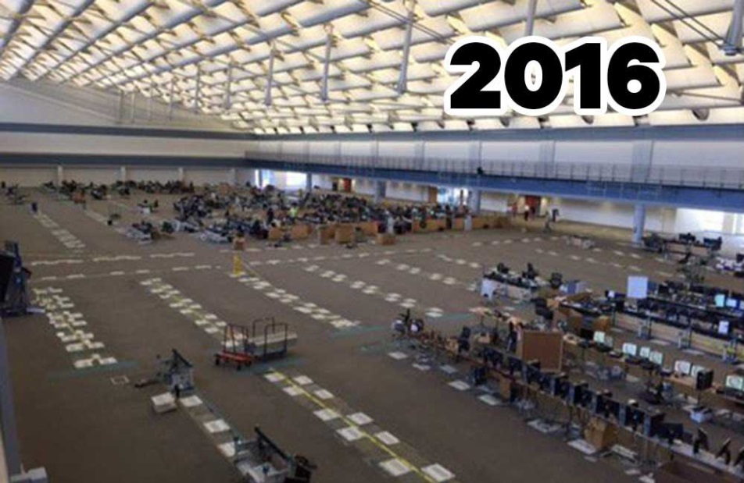
Industrial Practice – Biz
Main Drivers
Lower cost, less man power, speed and reduce error (in most circumstances)
8 Dealers for HK market -> 2 Dealer for APAC market
Traders becomes Sales Trading and Execution Consultants
Notes:
Before earn $10 share $5, now earn $10 but share only $1

Slide 7
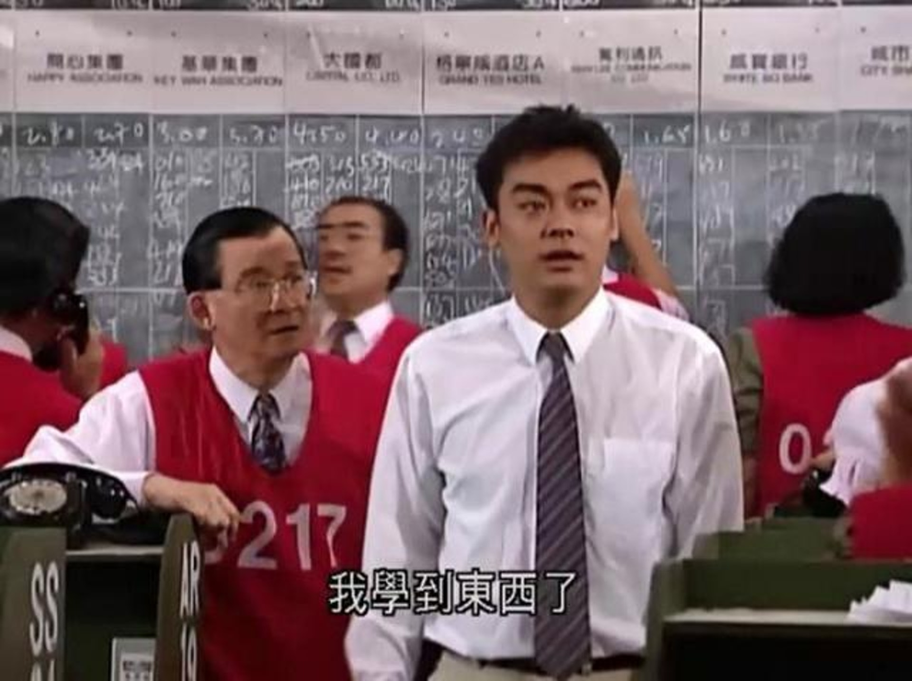
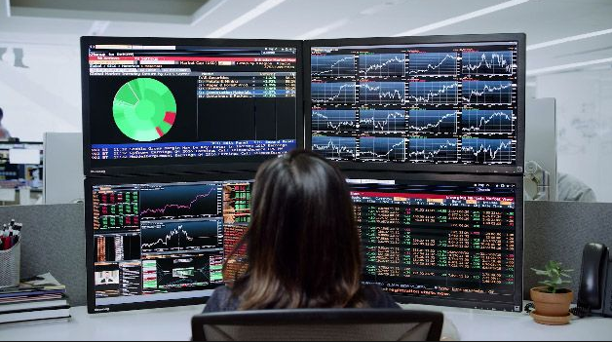
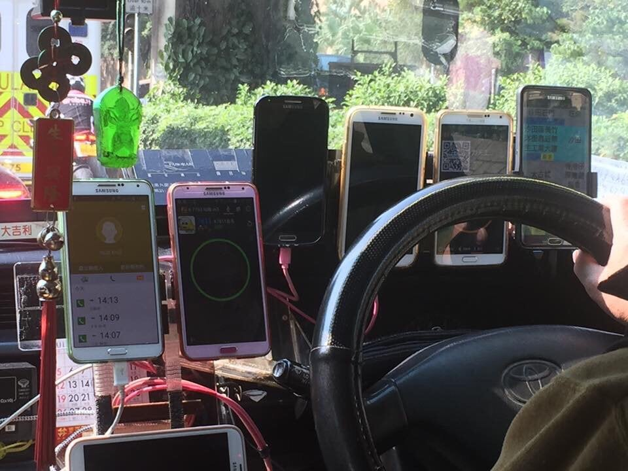
Industrial Practice – Trading Desk
Notes:
Before earn $10 share $5, now earn $10 but share only $1

Slide 8
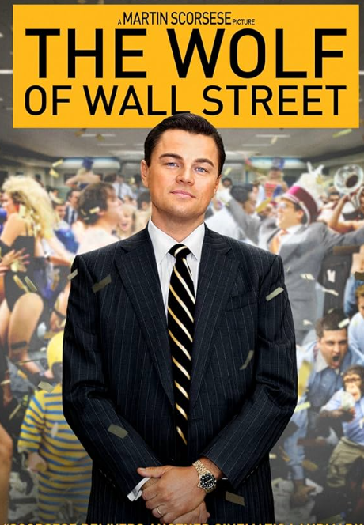
Trading Strategies
Trading for Money:
Beat the Markets: Index/Statistical Arbitrage, Trend Following, Equities Long/Short, Macro, Market Making
High Frequency Trading: Latency / Venue / Instrument Arbitrage
Trading for Commissions:
Agency Execution Algos (for institutional clients to break down large order for controlled market impact): VWAP, Implementation Shortfall
Prevent Information leakage: Stealth, Iceberg
Notes:
Before earn $10 share $5, now earn $10 but share only $1

Slide 9


Trading for Money
Can you tell me a sure win Algo Trading Strategy?
As a course instructor, I can only provide information and knowledge sharing on Algo Trading Strategies
Please tell me as I really want to earn a lot of money
The truth is I don’t have a sure-win strategy. Think of the reason why I am teaching here right now

Slide 10

Trading for Money
People: 3 tech guys startup (full-time)
Funding: Our own $HK300,000
Markets: Hong Kong
Systems: Fully automated trading systems.
Strategies: Technical Analysis
Trading Horizon: Day Trading

Slide 11
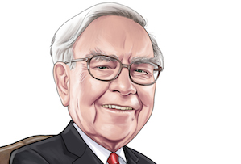


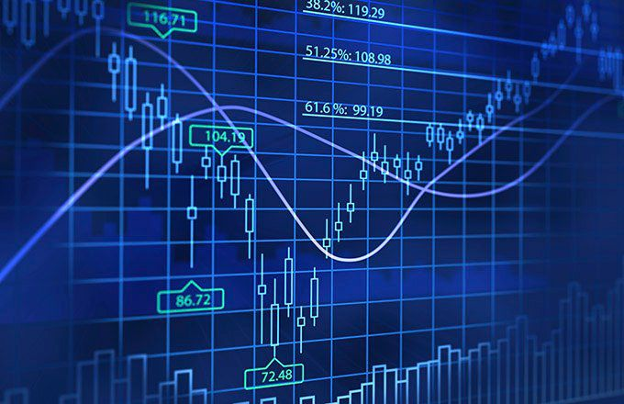
Trading Strategies – Technical Analysis
Value Investing Company, Management, Sector
Fundamentals: Earnings, P/E
Macros: GDP, Interest Rate CPI
Sell Overvalue, Buy Undervalue
Technical Analysis Price, Volume, Patterns
Reversion / Overbought, Oversold: Buy Low, Sell High
Trends / Momentum: Buy High, Sell Higher
Arbitrage: Mispricing

Slide 12

Trading Strategies – Technical Analysis
Market action discounts everything: assumed that fundamental factors are utilized in an indirect way as current price reflects all information contained in the past
Price moves in trends: price of a market is more likely to follow a previous trend rather than moving in a totally unpredictable manner
History repeats itself: human psychology which tends to react the same way in similar market conditions.
Fortune Teller: believe her or not

Slide 13

Trading Strategies – Day Trading
Day-trading: buys and sells a financial instrument within the same trading day, such that all positions are closed before the market closes for the trading day
Day-trader = Gambler?
Love, Harry. Love.
係愛呀, 哈利
We do day-trading, not because we’re short-term speculators or gamblers. It’s because we love our family as we don’t have to monitor other markets when we back home.

Slide 14
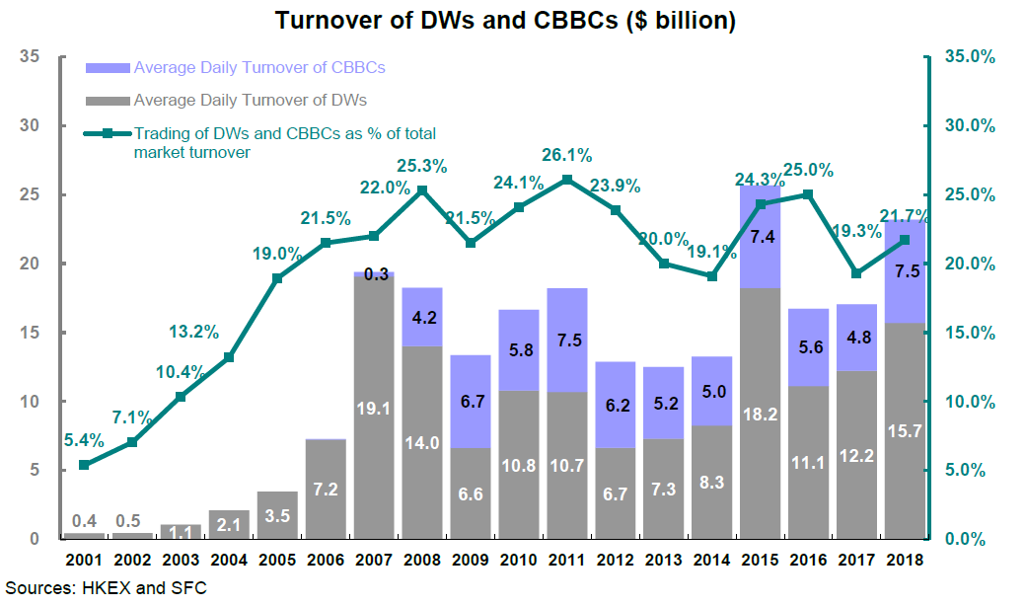
Trading Strategies – HK Warrant
Has enough liquidity and volatile enough for day trading
Back by big issuers (investment banks)

Slide 15
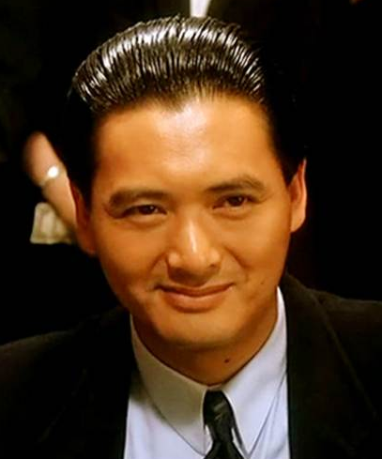
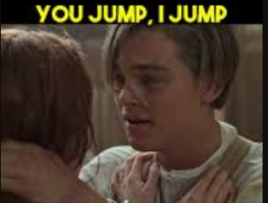
Trading Strategies – HK Warrant
Objective: Try to follow a “super trader” (like God of Gambler 賭神) and profit from it. Similar to Social Trading / Trending Following
TRADE
TRADE
Step 1: Identify a super trader
Step 2: Follow his trade

Slide 16
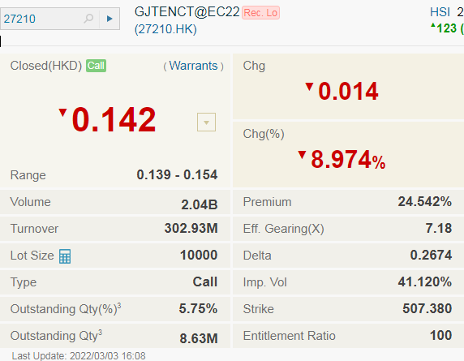
Trading Strategies – HK Warrant
Automated trading system monitors few hundred active warrants in real-time for the following conditions:
1. Enter Trade when “suspected” super user trade
Large Notional:
a single trade > $50,000
Price move up immediately:
Best Bid price move up
(>= 1 tick within 5s)
Lot Size is a minimum buying unit
$0.142 * 10,000 = 1,420
Price change 8.974% volatile enough for day trading

Slide 17
Trading Strategies – HK Warrant
Size | Bid | Ask | Size
1,200,000 | 0.141 | 0.142 | 3,200,000
5,520,000 | 0.140 | 0.143 | 6,150,000
7,000,000 | 0.139 | 0.144 | 8,000,000
Min | Max | Tick Size
0.01 | 0.25 | 0.001
0.25 | 0.5 | 0.005
0.5 | 10 | 0.01
10 | 20 | 0.02
20 | 100 | 0.05
100 | 200 | 0.1
200 | 500 | 0.2
500 | 1000 | 0.5
1000 | 2000 | 1
2000 | 5000 | 2
5000 | 9995 | 5
Trade: 500,000 @ 0.142 (=$71,000)
Best bid up 1 tick within 5s
Size | Bid | Ask | Size
1,300,000 | 0.142 | 0.143 | 6,150,000
1,520,000 | 0.141 | 0.144 | 8,000,000
5,520,000 | 0.140 | 0.145 | 7,320,000
Tick Size: the smallest unit of price increment or decrement
Enter Trade: Buy 300,000 @ 0.143 (=$42,900)

Slide 18
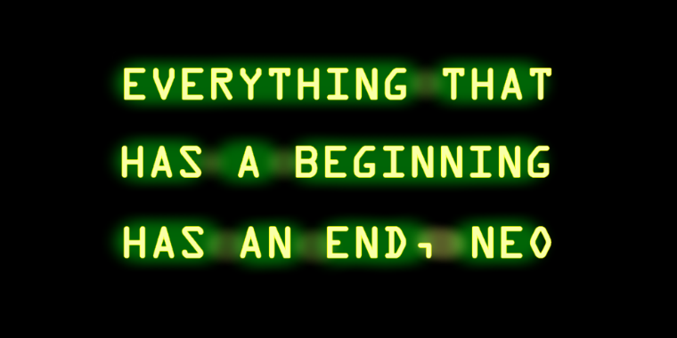


Trading Strategies – HK Warrant
TRADE
Open Position: Long (Buy) Warrant GJTENCT
Our trade needs an exit strategy !

Slide 19

Trading Strategies – HK Warrant
2. Exit Trade in these 3 conditions
Stop Profit
when warrant price move up
Sell if best bid + 2 ticks >= avg px
Example: avg px = 0.143, best bid = 0.145 profit = 0.002 and 1.41%
~ 1% profit after transaction cost ~ $429 profit for the $42,900 trade
Size | Bid | Ask | Size
1,300,000 | 0.142 | 0.143 | 6,150,000
1,520,000 | 0.141 | 0.144 | 8,000,000
5,520,000 | 0.140 | 0.145 | 7,320,000
Size | Bid | Ask | Size
1,300,000 | 0.145 | 0.146 | 6,150,000
1,520,000 | 0.144 | 0.147 | 8,000,000
5,520,000 | 0.143 | 0.148 | 7,320,000

Slide 20

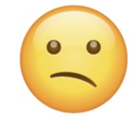
Trading Strategies – HK Warrant
2. Exit Trade in these 3 conditions
Stop Loss
when warrant price move down
Sell if avg px – best bid >= 5 ticks
Time: 15 mins before market close
Size | Bid | Ask | Size
1,300,000 | 0.142 | 0.143 | 6,150,000
1,520,000 | 0.141 | 0.144 | 8,000,000
5,520,000 | 0.140 | 0.145 | 7,320,000
Size | Bid | Ask | Size
1,300,000 | 0.138 | 0.140 | 5,550,000
1,520,000 | 0.137 | 0.141 | 1,500,000
5,520,000 | 0.136 | 0.142 | 1,320,000

Slide 21
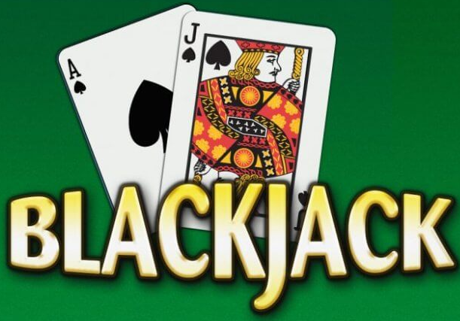
Trading Strategies – HK Warrant
3. Trading Parameters Optimizations
Stop Profit: Sell if best bid + 2 ticks >= avg px
Stop Loss: Sell if avg px – best bid >= 5 ticks
Canberra Blackjack Experience for the 5 ticks stop loss

Slide 22
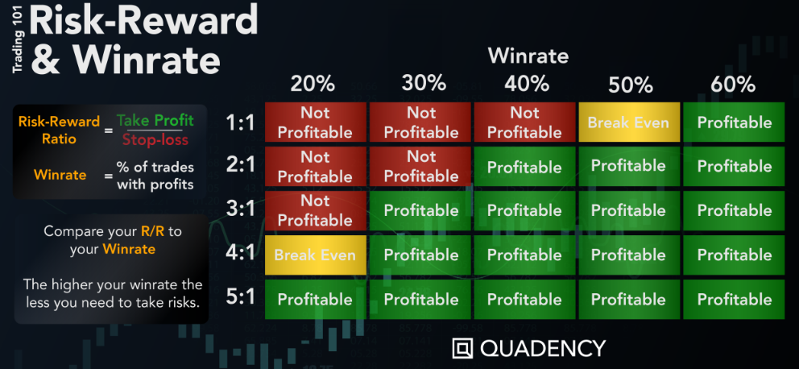
Trading Strategies – HK Warrant
Possible Stop Profit / Loss enhancements
Analyze the Risk-Reward and Win-rate from the back-testing
Predicting underlying short term movement with Machine Learning techniques

Slide 23
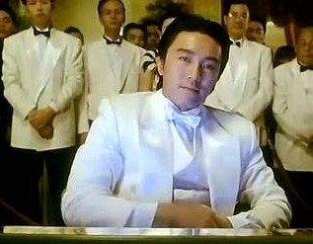
Trading Strategies – HK Warrant
Betting Size (Notional $)
When you lose the first bet with $1, how much will you bet in the next game (assume 50/50 odd)?
Same $1
More than $1
Less than $1
All-in
All-in !
晒你冷 !
Rather than placing same notional or randomly each time, optimizing the betting size for each trade…

Slide 24
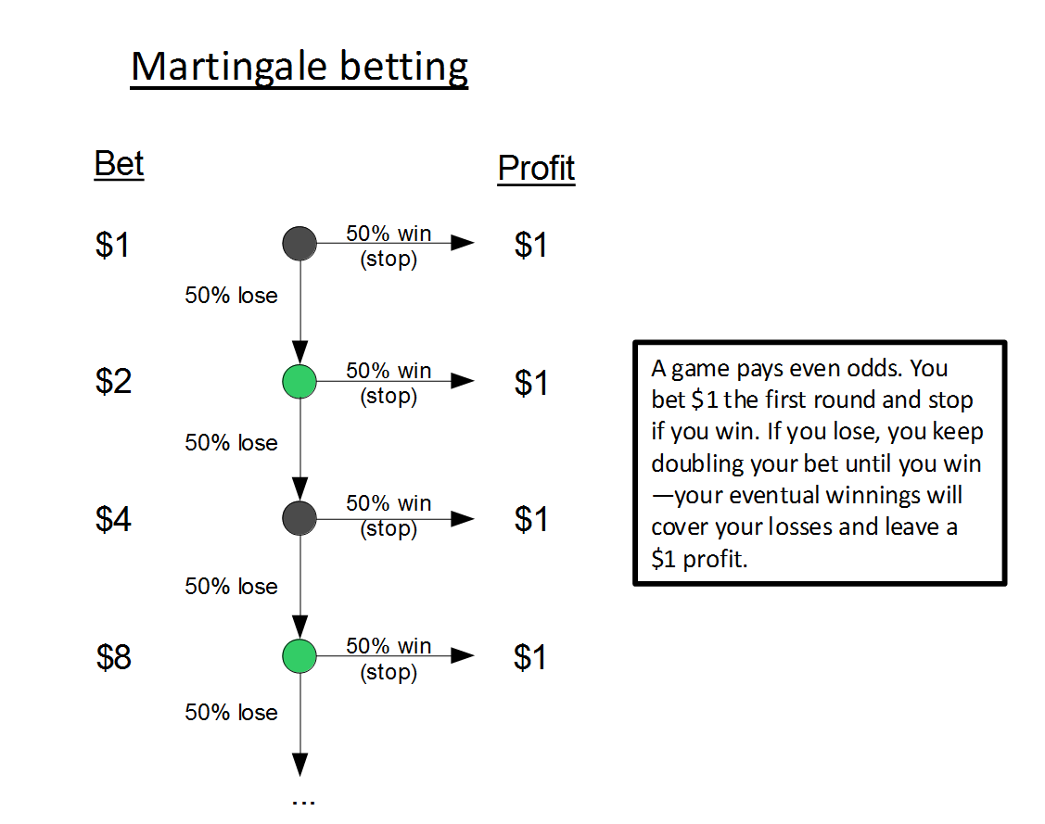
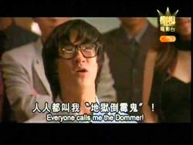
Trading Strategies – HK Warrant
Bet $1 the first round and stop if win
If you lose, keep doubling the bet until you win
Eventual winning will cover all your previous losses and have $1 profit
 | Bet$ | 50% Loss | 60% Loss
1 | $1 | 50.00% | 60.00%
2 | $2 | 25.00% | 36.00%
3 | $4 | 12.50% | 21.60%
4 | $8 | 6.25% | 12.96%
5 | $16 | 3.13% | 7.78%
6 | $32 | 1.56% | 4.67%
7 | $64 | 0.78% | 2.80%
8 | $128 | 0.39% | 1.68%
9 | $256 | 0.20% | 1.01%
10 | $512 | 0.10% | 0.60%
地獄黑仔王
Bad luck as hell

Slide 25
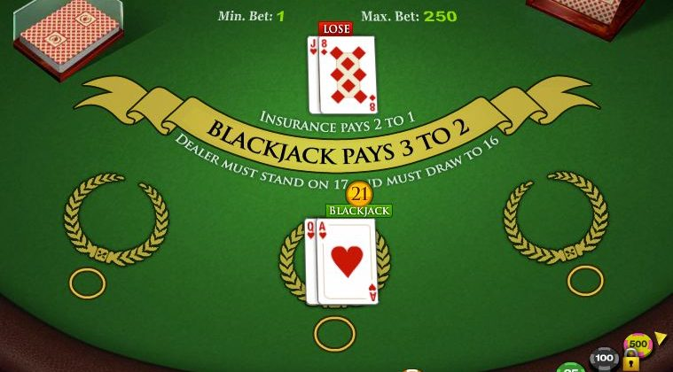
Trading Strategies – HK Warrant
Kelly Bet: is a formula for bet sizing that leads almost surely to higher wealth compared to any other strategy in the long run

Slide 26
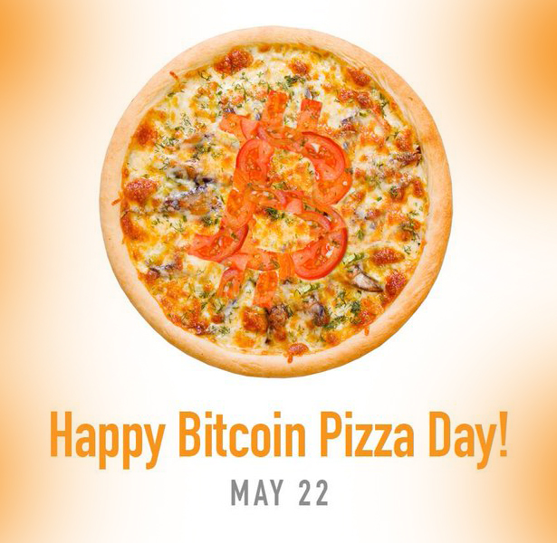
Demo: Bit Coin Trading
2010-May-22:
Laszlo Hanyecz agreed to pay 10,000 Bitcoins for two delivered Papa John's pizzas
2025-Aug-11:
1 bitcoin = US$ 120,000 (~HK$ 874,000)
2 Pizzas worth:
US$ 1.2 Billons
HK$ 8.7 Billons

Slide 27
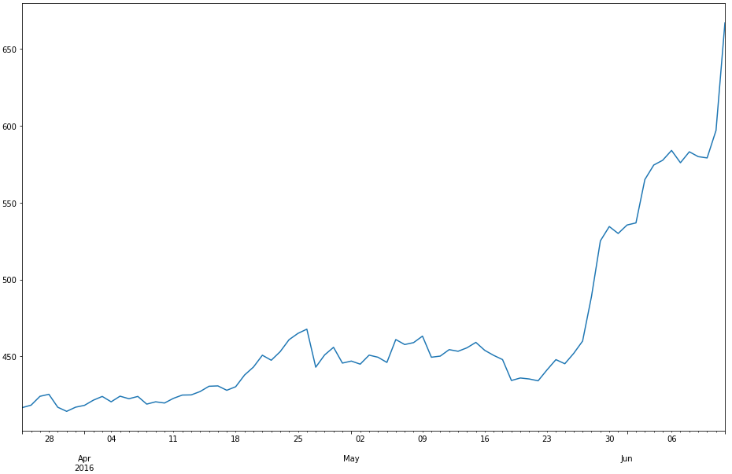
Demo: Bit Coin Trading
2016-May-22:
1 bitcoin = US$ 434 (~HK$ 3,385) 100 bitcoins = US$ 43,400 (~HK$ 338,500)
2025-Aug-11:
1 bitcoin = US$ 120,000 (~HK$ 874,000) 100 bitcoin = US$ 12,000,000 (~HK$ 93,600,000)
My Bitcoin Pizza Day

Slide 28
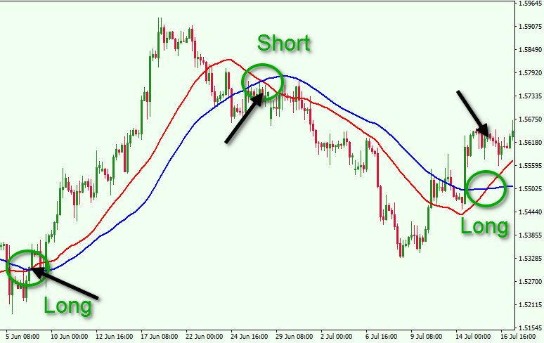
Demo: Bit Coin Trading
SMA (Simple Moving Average) Crossover Strategy: leading and lagging SMA
Short Sell Example
Date | Bitcoin Px | Action
2022/3/5 | 40,000 | Short (sell) 1 bitcoin and get $40,000
2022/3/12 | 35,000 | Buy and return 1 bitcoin back at $35,000 Profit is $(40,000 – 35,000) = $5,000
Code Example

Slide 29
Strategy Performance Evaluation
Portfolio A and B has the same return
Which one would you choose?
Sharpe Ratio Excess return (to risk-free asset) adjusted by risk (volatility)
Portfolio A is less volatile -> Higher Sharpe Ratio

Slide 30
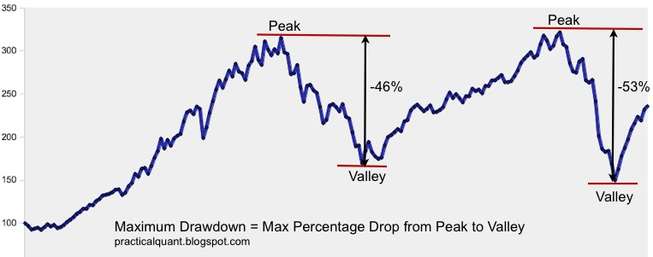
Strategy Performance Evaluation
Max Drawdown
Trigger stop loss to (partially) close the positions
Maintenance margin call
Fund redemption or shutdown

Slide 31

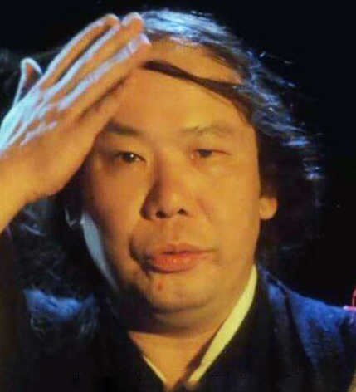
Back Testing Limitations
西門吹雪 (Simon Blow Snow)
Doesn’t consider the following:
Transaction Cost
Infrastructure cost
Commissions
Shorting (cost or legal)
Slippage (Latency, Spread, Volatility, Liquidity)
Market Impact
Back Testing
Real Trading

Slide 32
Back Testing Limitations
Selection Bias: happens to see a positive result based on certain set of data
Regime Switching: carefully select the period and beware of structural changes in a data series
Performance Tuning: adjust the algos logic and params to (over)fit your historic training data (does future repeat itself? back test results are usually “over fit”)
Paper Trading

Slide 33
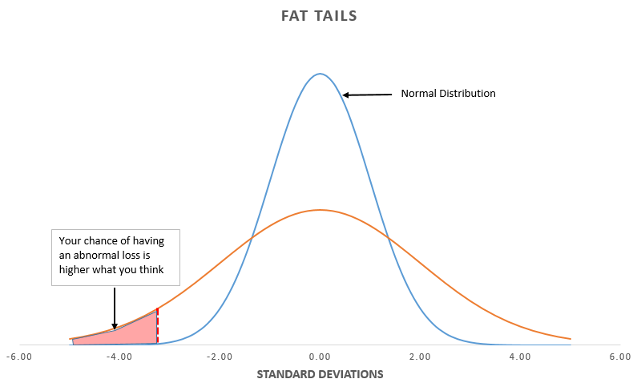
Back Testing Limitations
Fat-tail risk: extreme event happen more often than expected
500年一遇 once in 500 years

Slide 34
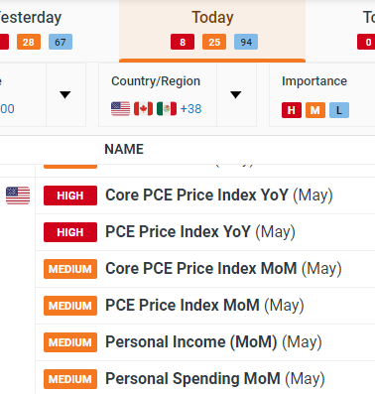
Risk Management
Order Level Stop Loss (e.g. 5%)
Max Daily Drawdown (e.g. 10%)
Max Portfolio Drawdown (e.g. 30%)
Close position before major event day or announcement
https://www.dailyfx.com/economic-calendar

Slide 35

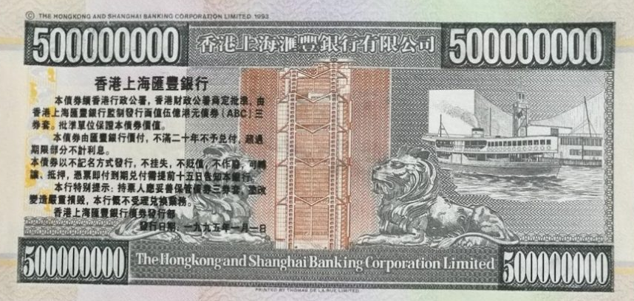
Agency Execution Algos
Trading for institutional clients such as insurance companies, mutual fund, hedge fund to earn commissions
Does not own the PnL of the traded asset
Trade only one side (either Buy, Sell, Short Sell)
Trading duration is usually short: minutes, hours
Order size/notional is general big
Notes:
Before earn $10 share $5, now earn $10 but share only $1

Slide 36
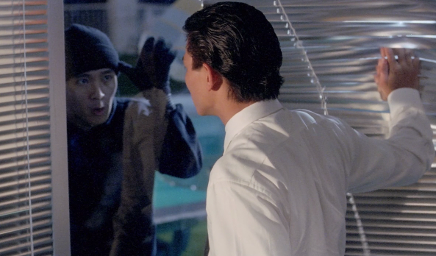
Type 1: Reduce Signaling Algos
Demand liquidity without signal the market
Objective: Hide the true intent
Example Algos: Stealth, Iceberg, Peg
You can’t see me
你睇我唔到 睇我唔到

Slide 37
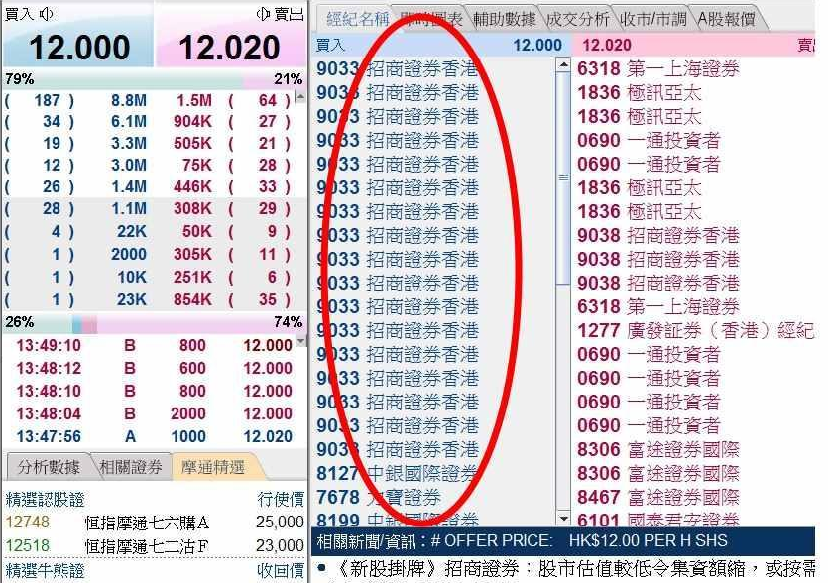
Algo - Stealth
HK Stock Exchange shows Broker IDs and set max order size at 3,000 lot
For a very large order, it has to breaks up into many smaller orders (each not exceeding 3000 lot)
Example Buy 1,000,000 Tencent. As max order size is 300,000 shares (3000 lot x 100 share), needs to send 4 orders to the exchange and hence shows 4 broker IDs in the order book broker queue

Slide 38
Algo - Stealth
Example : IPO Stabilization (護盤)
Bean Broker (BB) helps Alimama Ltd to go public. BB price the IPO at HK$10 and lot size is 1000 shares
BB also acts as the stabilizer. It tries to support the stock price not drop below the IPO price in the first 2 weeks.
In the first 2 weeks, BB queue up 50,000,000 (i.e. 17) buy orders during market open at IPO price
Broker Queue | Size | Bid | Ask | Size | Broker Queue
BB BB BB BB BB BB BB BB BB BB BB BB BB BB BB BB BB GS CS | 50,200,000 | 10 | 10.01 | 600,000 | GS CS DB SG GS CS MS MQ MQ
MS MS GS CS CS BB | 500,000 | 9.99 | 10.02 | 300,000 | CS DB DB GS MS MS
BA MQ BB CS GS | 700,000 | 9.98 | 10.03 | 200,000 | MS DB GS GS

Slide 39
Algo - Stealth
Example : IPO Stabilization (護盤)
During the first week of IPO, the board market sentiment is not good. Alimama doesn’t go up and trade around IPO price at HK$10.
Because of the stabilization duty, BB accumulates large Alimama stock positions (30,000,000 shares @ HK$10)
Luckily in the next week, the market sentiment improved and Alimama price starts to go up. Currently it’s trading at HK$11
As the stock price goes up, BB will unload some Alimama positions to reduce its exposure and make some profits on the rising price

Slide 40
Algo - Stealth
Example : IPO Stabilization (護盤)
BB plans to unload 10,000,000 shares of Alimama at each price increments (i.e. $11.01, $11.02, $11.03). Hence it sends the sell orders and queue at those prices
Broker Queue | Size | Bid | Ask | Size | Broker Queue
GS CS DB MS MS GS | 300,000 | 11 | 11.01 | 10,300,000 | BB BB BB BB MS MQ
MS MS GS CS CS BB | 200,000 | 10.99 | 11.02 | 10,500,000 | BB BB BB BB MS MS
BA MQ BB CS GS | 100,000 | 10.98 | 11.03 | 10,200,000 | BB BB BB BB GS
However, this will scare the investors from buying Alimama as large sell quantities are displayed and create downward impression. Also Alimama will not be happy to see the stabilizer is dumping their stocks

Slide 41
Algo - Stealth
Use Stealth Algo to unload the positions without showing in the order queue
Sell 10,000,000 @ 11.01 when it can hit the bid for immediate execution
Sell 10,000,000 @ 11.01 Sell 10,000,000 @ 11.02
Sell 10,000,000 @ 11.03
Stealth Algo
Monitoring the market
No Action ! (Best Bid 11 < 11.01)
Broker Queue | Size | Bid | Ask | Size | Broker Queue
GS CS DB MS MS GS | 300,000 | 11 | 11.01 | 300,000 | MS MQ
MS MS GS CS CS BB | 200,000 | 10.99 | 11.02 | 500,000 | MS MS
BA MQ BB CS GS | 100,000 | 10.98 | 11.03 | 200,000 | GS

Slide 42
Algo - Stealth
Order Type: Sell Market or Limit Order @ 11.01?
Quantity: Send all 10,000,000 shares out?
Order Condition: IOC (Immediate or Cancel) (aka Fill and Kill)
Sell 10,000,000 @ 11.01 Sell 10,000,000 @ 11.02
Sell 10,000,000 @ 11.03
Stealth Algo
The order quantity is randomized and smaller than the best bid size (so won’t move the price)
Monitoring the market
Sell 297,000@11.01 Limit IOC order to hit the Bid
Broker Queue | Size | Bid | Ask | Size | Broker Queue
MS MQ | 300,000 | 11.01 | 11.02 | 500,000 | MS MS
GS CS DB MS MS GS | 300,000 | 11 | 11.03 | 200,000 | GS
MS MS GS CS CS BB | 200,000 | 10.99 | 11.04 | 400,000 | DB MQ GS

Slide 43
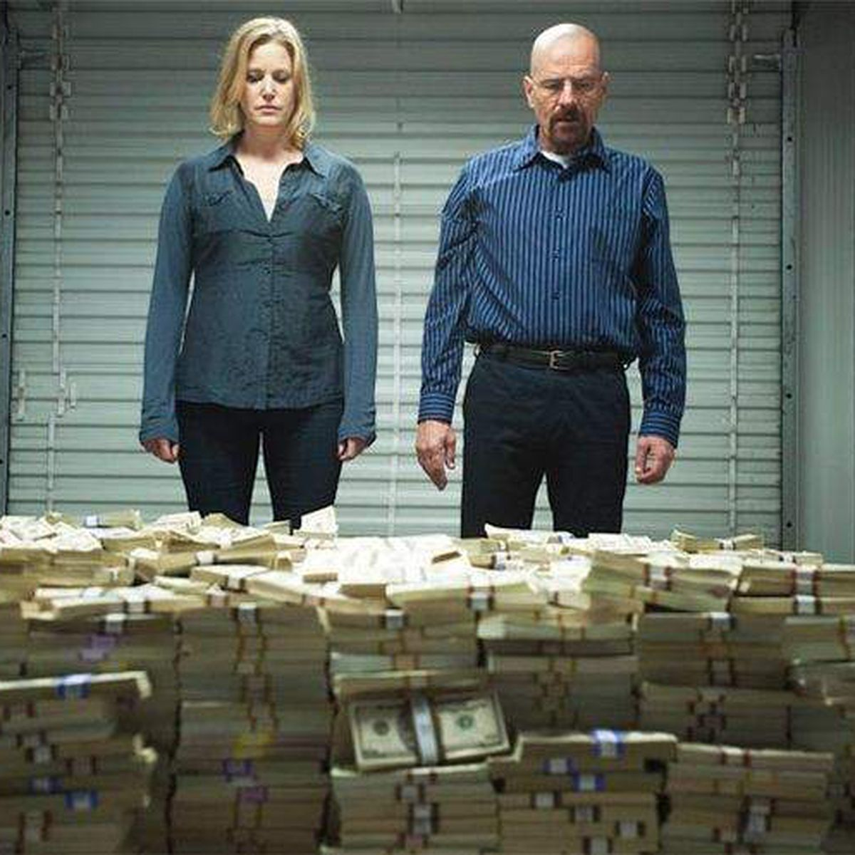
Algo - Stealth
By leveraging this simple Stealth Algo make, the stabilization trade can make a decent profile.
Luck and Capital
It is a rare opportunity as IPO stocks usually trade above IPO price during the initial periods and thus the brokerage firm won’t able to accumulate positions at this IPO stabilization price
However, it requires a lot of preparations to get the IPO deals and capital to support the price

Slide 44

Algo - Iceberg and Peg
Iceberg
only send (display) partial order quantity to the exchange at each time
refill the quantity when see fills
randomize the display quantity
broker ID market may only send new order after the partial order fully filled
Peg
float partial order to follow Bid/Mid/Ask price
can have offset (+/- x ticks from the above price)

Slide 45
Algo - Iceberg and Peg
Size | Bid | Ask | Size
2,000 | 9.5 | 9.6 | 1,000
 | 9.4 | 9.7
 | 9.3 | 9.8 | 2,000
1,000 | 9.2 | 9.9 | 1,000
1,000 | 9.1 | 10.0
Use case?
illiquid stocks
In general, when trading relatively large order, it is better not to display the whole order size as it may create unnecessary market signals. Worse still, other investors may trade against it.

Slide 46
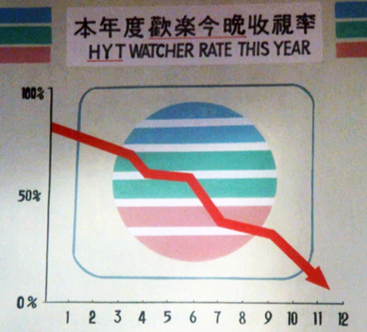
Type 2: Benchmark Algos
Size: Institutional orders can be large on size and $ notional
Duration: usually less than a day
Objective: reduce market impact and track or beat the price / volume benchmarks
Best Execution: buy at lower price and sell at higher price
Example Algos: POV, IS, VWAP/TWAP, MOC

Slide 47
Algo – POV (%Volume Benchmark)
Example
Breaking news reports that a meeting between Chinese officials and tech CEOs went well, leading to expectations of policy support. As a result, Chinese tech stocks are rising rapidly.
The AA fund aims to purchase 1 million shares of Tencent as quickly as possible.
Objective | With a strong price view (go up) and target to complete the order as soon as possible
Urgency | High

Slide 48
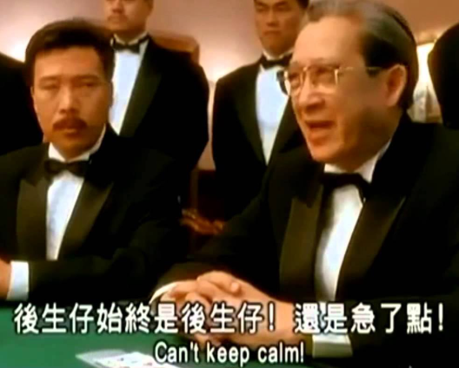
Algo – POV (%Volume Benchmark)
AA Fund buy 1 million shares immediately at one-go
Size | Bid | Ask | Size
20,000 | 580 | 580.2 | 70,000
80,000 | 579.8 | 580.4 | 90,000
70,000 | 579.6 | 580.6 | 80,000
50,000 | 579.4 | 580.8 | 30,000
10,000 | 579.2 | 581 | 50,000
20,000 | 579 | 581.6 | 70,000
88,000 | 578.8 | 582 | 60,000
75,000 | 578.2 | 582.8 | 10,000
70,000 | 578 | 583.6 | 88,000
90,000 | 577.2 | 585 | 27,000
88,000 | 577 | 587.2 | 60,000
75,000 | 576.6 | 588.8 | 100,000
170,000 | 576.4 | 590 | 188,000
190,000 | 575 | 592 | 127,000
Push up the price by 2%
Avg. Executed Price = $585.3 (~ 1% higher than the initial ask price)

Slide 49
Algo – POV (%Volume Benchmark)
POV (% Volume) – execute an order relatively quick but do not cause too much market impact by itself.
POV% parameter controls the execution speed. Algo will try to make its executed volume to be POV% of the market executed volume.
QTY = POV% * MEV – OEV
QTY - quantity to be executed
POV% - POV parameter. e.g. 30%
MEV - Market executed volume since strategy started
OEV - Order executed volume since strategy started
Error Checks : Reject order with POV% > 50 as too much market impact. Industry practice is 33% for max desired impact

Slide 50
Algo – POV (%Volume Benchmark)
Example: Buy 1,000,000 shares of 0700.HK (Tencent) with POV% = 30%
QTY = POV% * MEV – OEV
Trade | Size | MEV (Market) | OEV (Order) | QTY | Actual POV (OEV+QTY)/MEV
T1 | 2,000 | 2,000 | 0 | 600 | 0.3
T2 | 1,000 | 3,000 | 600 | 300 | 0.3
T3 | 5,000 | 8,000 | 900 | 1,500 | 0.3
T4 | 3,000 | 11,000 | 2,400 | 900 | 0.3
Additional parameters
Active: more willing to trade and track closer to the target
Normal: balance the speed and price improvement
Passive: more willing to wait for price improvement

Slide 51
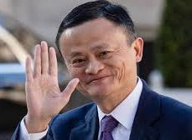
Algo – POV (Volume Counting)
Off-Exchange Trade such as block crossing or private stock placement is excluded
Type | Description
D | Odd lot transaction
M | Manual or Special lot non-Direct Business transaction
P | Pre-open transaction (trade concluded before market open including that concluded but not recorded in the system before market close of the previous trading day)
U | Auction transaction
X | Manual or Special lot Direct Business transaction
Y | Automatch Direct Business transaction
"" | Automatch non-Direct Business transaction
* | Rejected/Cancelled transaction
Alibaba's Jack Ma
sells $9.6 billion shares

Slide 52
Algo – POV (Volume Counting)
If the POV Algo order has a limit price (a price cap)
Buy order cannot buy higher than the limit price. Similarly, sell order cannot sell lower than the limit price
Example: Buy 30% POV @ limit price = 580
Size | Bid | Ask | Size
20,000 | 580 | 580.2 | 70,000
80,000 | 579.8 | 580.4 | 90,000
70,000 | 579.6 | 580.6 | 80,000
10,000@580.2
20,000@580.2
13,000@580.2
Count the execution volume at 580.2?
When the order has a limit price, only count the ITM (in-the-money) volume to prevent excessive volume catch-up. Hence volume at 580.2 is NOT counted

Slide 53

Algo – POV (%Volume Benchmark)
Conclusion
POV is like Hong Kong Spirit
No need to rush,
but as quick as possible
(唔洗急,最緊要快)

Slide 54
Algo - Implementation Shortfall
Example
An opportunistic fund believes the DeepSeek effect has a short to medium term (few weeks to months) positive impact to the Chinese tech sector stocks.
The fund decides to buy 1M shares of Alibaba into the portfolio now. It expects this trend will last for a short period of time (e.g. 1 month) and will unwind the position when reaching a 20% return.
Objective | Complete the order at or better than the decision price (usually is the order arrival price) which will help to preserve the Alpha (the expected 20% profit)
Urgency | Medium - as the price view is for weeks to months.

Slide 55

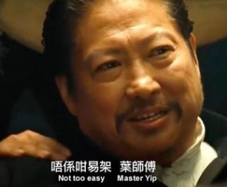
Algo - Implementation Shortfall
Master Ip: Just execute all the quantity at the order arrival to get the arrival price
Master Ip: Execute it slowly to reduce the market impact
Master Hung: Not too easy. You will push up the stock price (away from the arrival price) and cause large market impact
Master Hung : Execute it too slowly, the price may also run away (opportunity cost and timing risk)

Slide 56
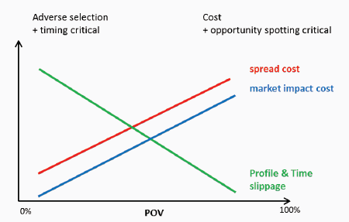
Algo - Implementation Shortfall
Implementation Shortfall (IS): the difference between the decision price (usually arrival mid-price and the final execution price for a trade (aka the slippage).
Scheduling
The Algo generally balance the pace of executing too fast (market impact cost) vs too slow (opportunity cost of the price move away). The POV% increases when price is more favorable and vice versa.
Notes:
Assume mean-reversion.

Slide 57
Algo - Implementation Shortfall
The POV% increase when price is more favorable.
Buy Price | POV%
5.6 | 10
5.5 | 15
Arrival Px → 5.4 | 20
5.3 | 25
5.2 | 30
Price becomes more favorable
Faster execution
This model implicitly assumes “mean reversion” (i.e. prices and returns eventually move back towards the mean or average). If stock is trending, may use other Algos (which one?).
Notes:
Assume mean-reversion.

Slide 58
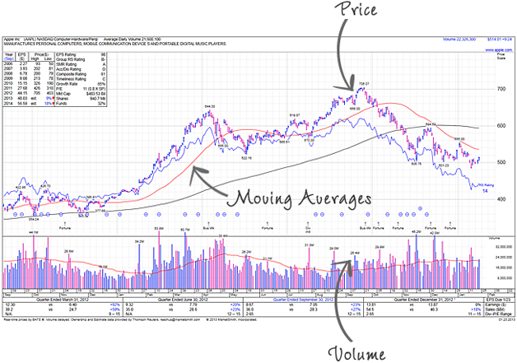
Algo - Implementation Shortfall
The POV% increase when price is more favorable. The numbers varies from different stocks and generally based on the stock cost model where mainly taking into account:
Volatility (Price): price change rapidly and unpredictably. Stocks usually have large open close price difference
Liquidity (Volume): can be quickly bought or sold in the market. Stocks have high daily volume and best/Ask spread is usually tight

Slide 59
Algo - Implementation Shortfall
Historical Volume : More Volume ->
Liquidity : High Liquidity ->
Volatility : High Volatility ->
Spread: Wide Spread ->
Notes:
Assume mean-reversion.

Slide 60
Algo - VWAP
Example
As more companies adopt AI, an long-term fund believes the Tencent stock will have better return in the next 5 to 10 years. The long-term fund decides to buy 1M shares of Tencent within today into the portfolio for a long term investment.
Objective | Complete the (large) order gradually with minimal market impact
Urgency | Low - as the price view is for long-term growth

Slide 61
Algo - VWAP
VWAP (Volume Weighted Average Price) is a benchmark Algo which try to track or beat the volume adjusted average market price over the order trading duration.
Trade 1: 10,000 shares @ $70
Trade 2: 20,000 shares @ $72
VWAP = (10,000 * 70 + 20,000 * 72) / (10,000 + 20,000) = 71.33
Trading Objective: trade a sizable CD (careful discretion) order that the trader does not have a specific view to the market direction during the trading horizon.
If there’s a view on the market direction, for example, buy order on a trending up market. For this case, the order is preferred to be traded by liquidity seeking algo, such as POV, that completes the order as quick as possible rather than worked by VWAP Algo gradually over the day (as the view is that the price is going to go up and buy earlier will give a better price).

Slide 62

Algo - VWAP
Example: VWAP Buy 1,000,000 shares of Tencent over-the-day (9am to 4pm)
To benchmark the weighted average price (VWAP), how hard is it?
You don’t know the target (i.e. weighted average) until the end of the trading day
Have over 6 hours to trade this order, how to schedule the execution progress?
羅志祥 - 時間管理大師
Show Lo – Master of Time Scheduler
Just randomly pick a time and execute at one-shot?
Evenly distribute the execution over the trading hours?
Trade more when there will be more volume?

Slide 63
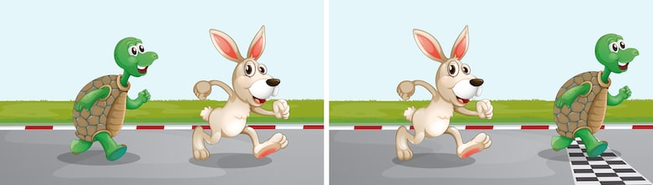
Algo - VWAP
Scheduling
Example: VWAP Buy 1,000,000 shares of Tencent over-the-day (9am to 4pm)
Execution progress throughout the trading duration is based on a historical volume profile to predict the current day volume pattern.
The profile is usually constructed based on 20 days average (or median) and taking away the outliers and special trading days (like half day trading or index rebalance days).

Slide 64
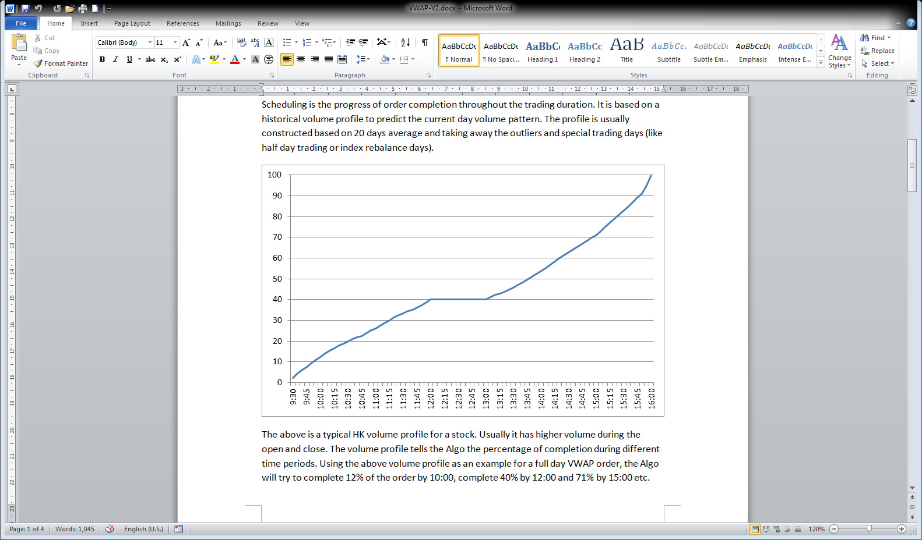
Algo - VWAP
A typical HK volume profile for a stock. Usually it has higher volume during the open and close. The volume profile tells the Algo the percentage of completion during different time periods.
Example
VWAP Buy 1,000,000 Tencent
Time | Target% | Target Qty
10:00 | 12% | 120,000
12:00 | 40% | 400,000
15:00 | 71% | 710,000
16:00 | 100% | 1,000,000
Usually more volume at open and the close

Slide 65

Algo - VWAP
Stock historical volume profile seems a good proxy to predict the current day volume pattern. Should every stocks has its own volume profile?
Not every stocks should have an individual stock volume profile
Only stocks that exhibit high correlation in daily volume patterns (It means those stocks exhibit relatively consistent volume patterns. Those stocks are usually the liquid stocks (for example from stocks from Hang Seng Index)
For those stocks (usually mid-cap or illiquid stocks) that they do not have consistence volume profile, use market volume profile or TWAP

Slide 66
Algo - TWAP
TWAP (Time Weighted Average Price) is everything the same as VWAP Algo, except it does not use volume profile. Instead, the schedule is equally divided by the trading duration (can think of it as linear volume profile).
Use Case
Mid-cap or illiquid names that do not have stable daily volume patterns
Popular in markets that the volume patterns are not dominant (usually the markets with no lunch break and with short trading hours, such as Taiwan)

Slide 67
Algo - VWAP
Order Placement
According to volume profile schedule, the Algo will decide on how to place the orders (price and quantities) to the exchange to achieve the target while getting the best possible price.
Example
VWAP Buy 1,000,000 Alimama
Time | Target% | Target Qty
10:00 | 12% | 120,000
12:00 | 40% | 400,000
15:00 | 71% | 710,000
16:00 | 100% | 1,000,000
How would you buy 12% (120,000) shares of Alimama by 10am?
Notes:
SG market has long order queue

Slide 68
Algo - VWAP
Order Placement
Target: Buy 12% (120,000 shares)
Alimama order book at 10am
Size | Bid | Ask | Size
10,000 | 9.5 | 9.6 | 20,000
50,000 | 9.4 | 9.7 | 50,000
70,000 | 9.3 | 9.8 | 80,000
Option 1: Immediately buy 120,000 at 10am
Executions: 9.6@20,000, 9.7@50,000, 9.8@50,000
Average Executed Price: 9.725
Ideally, should get a lower execution price at 9.5
Notes:
SG market has long order queue

Slide 69
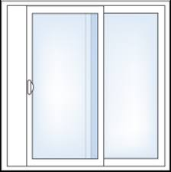
Algo - VWAP
Ahead or behind Window
Slower
Faster
Behind
Ahead
Trade more frequently with smaller order size.
Allow a 2% to 5% deviation (window size) from the volume profile target.
The windows size depends on the stock rice volatility. Usually more volatile stock has narrower window size (reduce tracking error)
Start with passive order to improve the pricing and work progressively if the Algo is starting to get behind the schedule. (i.e. for buy order, send some order quantity to best bid first)
Notes:
SG market has long order queue

Slide 70
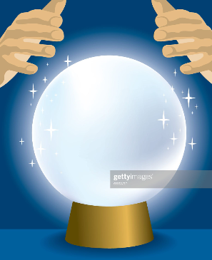
Algo - VWAP
Order Book Features
VWAP Algo choose to behind the schedule (trade slower) or ahead (trade faster) according to the predicted short term price direction. The prediction is based on Order Book features
Trade slower if the stock price is predicted to becoming more favourable (i.e. price go down for Buy order)
Size | Bid | Ask | Size
10,000 | 9.5 | 9.6 | 20,000
50,000 | 9.4 | 9.7 | 50,000
70,000 | 9.3 | 9.8 | 80,000

Slide 71
Algo - VWAP
For Buy order, trade faster or slower now?
Size | Bid | Ask | Size
1,000,000 | 9.5 | 9.6 | 20,000
50,000 | 9.4 | 9.7 | 50,000
70,000 | 9.3 | 9.8 | 80,000
Order Book Imbalance
The ratio between the bid and ask size. We can take into account the first few levels (for example 3 levels) of the order book while the top level of the book will have higher weighting.
For buying order, if the bid size is much larger than the ask size, the VWAP Algo should be more willing to trade aggressively as the price is more likely to go up rather than down. Vice versa, if the Ask size is larger, the Algo should wait more patiently.

Slide 72
Algo - VWAP
Current Order VWAP is 9.9; for Buy order, trade faster or slower now?
Size | Bid | Ask | Size
20,000 | 9.5 | 9.6 | 20,000
50,000 | 9.4 | 9.7 | 50,000
70,000 | 9.3 | 9.8 | 80,000
Order Running VWAP price vs Current Market Price
During trading, the Algo will compare the order running VWAP price to the current market price. If the current market price is better than the VWAP price, the Algo should be more aggressive to execute as it will improve the overall VWAP pricing.
In the above example, the Buy Order running VWAP Price is 9.9, and the current market is offering at 9.6, the Algo should be more active to take offer at 9.6 now.

Slide 73
Algo - VWAP
For Buy order, trade faster or slower now?
Size | Bid | Ask | Size
20,000 | 9.5 | 9.9 | 20,000
60,000 | 9.4 | 10.0 | 50,000
70,000 | 9.3 | 10.1 | 80,000
Assume Tick Size = 0.1
Bid/Ask Spread
Bid/Ask spread is the price different between bid and ask. It is the transaction cost when Algo crossing the spread to get immediate executions.
When the Bid/Ask is wide (how to determine it’s wide or not?), the Algo should wait more patiently for the spread to be narrowed and avoid crossing the spread. Alternatively. Algo can also send the orders between the bid/ask price to narrow the spread by itself.

Slide 74
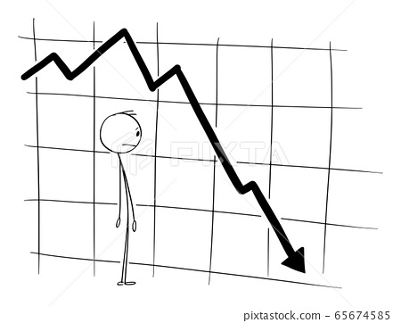
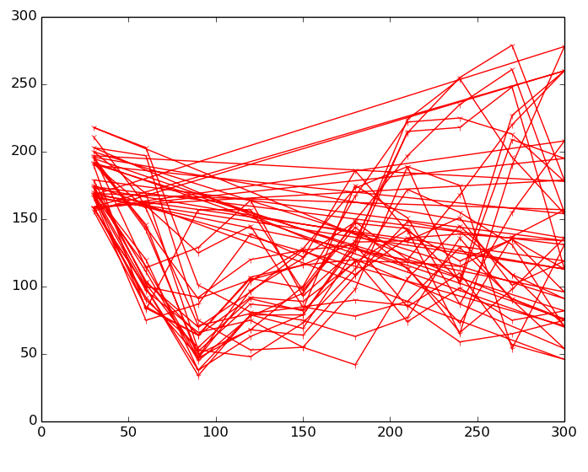
Algo - VWAP
Each order book factor is simple but put it altogether would require tuning the weightings.
Tuning one set of weightings for all stocks or each stock has it’s own weightings?
One set of weightings for all stocks would be too generic and may not well for all stock as different stocks has different characteristic
For each stock has it’s own weightings, it may not capture some correlations between similar stocks

Slide 75
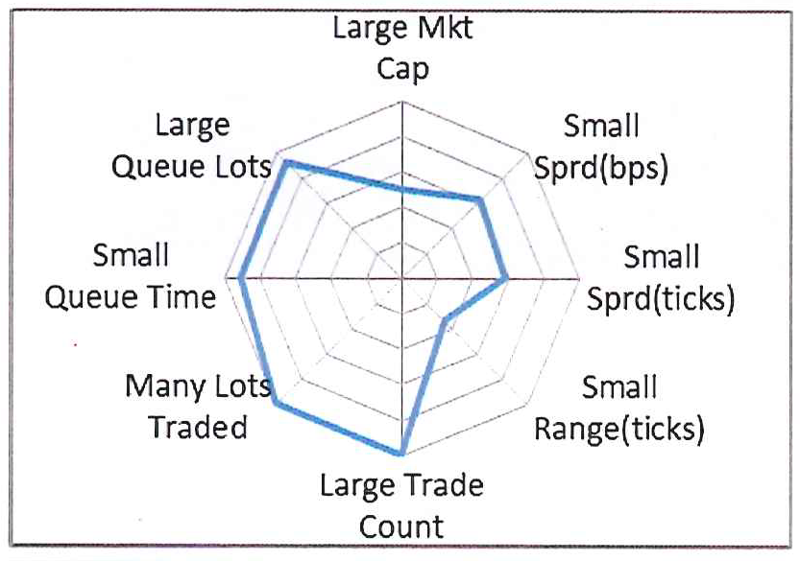
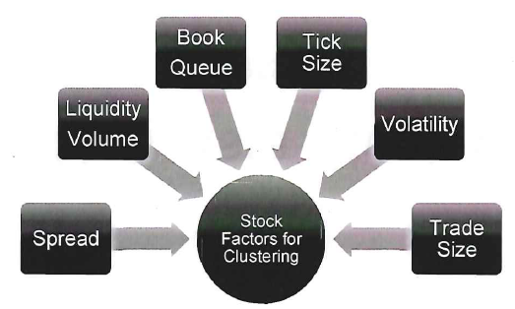
Algo - VWAP
Clustering
Group stocks with similar characterises into one cluster and set with the same weightings
Source: Goldman Sachs Securities Division

Slide 76
Algo - VWAP
Exchange Orders Management
Order book queue priority:
Price : higher price for Buy (lower price for Sell) has higher queue priority
Time : within the same price queue, earlier order has higher priority
When Algo needs to amend or cancel the orders in the exchange, it will always pick the one that loses the least queue priority from the price queue.
In the order book below (T denotes the orders from others, O is our orders. Smaller number indicates higher queue priority as they have been input to the book earlier), suppose we have to cancel one order at the 9.5 Bid queue, the Algo will cancel O16.
Broker Queue | Size | Bid | Ask | Size
T11, O12, T13, T14, T15, O16 | 1,000,000 | 9.5 | 9.6 | 20,000
T21,T22,O23 | 500,000 | 9.4 | 9.7 | 50,000
T31,T32,T33,T34,T35 | 700,000 | 9.3 | 9.8 | 80,000

Slide 77
Algo - VWAP
Exchange Orders Management
Order Actions:
Amend Quantity down ->
Amend Quantity up ->
Amend Price ->
preserve queue priority
lose queue priority
lose queue priority (in different price queue and at the end of the queue)
Broker Queue | Size | Bid | Ask | Size
T11, O12, T13, T14, T15, O16 | 1,000,000 | 9.5 | 9.6 | 20,000
T21,T22,O23 | 500,000 | 9.4 | 9.7 | 50,000
T31,T32,T33,T34,T35 | 700,000 | 9.3 | 9.8 | 80,000

Slide 78
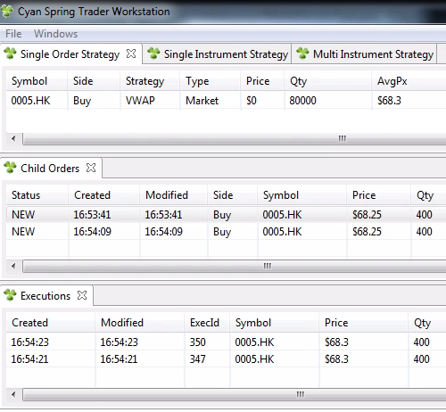
Algo - VWAP
Exchange Orders Management
One VWAP Algo order manages many Child (Exchange) orders.
If Algo needs to send 800 Qty to the exchange. Which one is preferred?
1 order x 800 QTY
2 orders x 400 QTY
Generally send 2 orders x 400 QTY so that we can have more flexibility to amend different child orders.
Notes:
SG market has long order queue

Slide 79
Algo - VWAP
Exchange Orders Management
When VWAP Algo is behind the execution schedule, it requires to get some fills to catchup the schedule.
With two child orders in the exchange, what should the Algo now?
Amend the newer order price to get fill
Send a new order to get fill
Notes:
SG market has long order queue

Slide 80
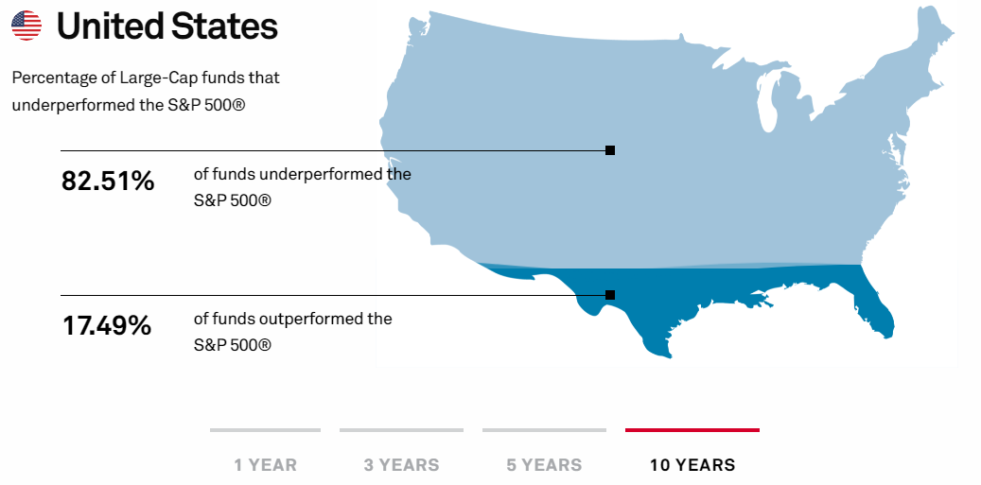
Algo – Market On Close
Passive tracking funds provide cost-effective (low management fee) alternative to active funds (annual fee 1-2%, 20% performance bonus)
This passive (index) tracking fund has good long term track record. Active discretionary investment may perform good for one year but not consistently over the next few years
Source: https://www.spglobal.com/spdji/en/research-insights/spiva/#us

Slide 81
Algo – Market On Close
Tracker Fund 盈富基金 (2800.HK) is an passive index tracking fund that replicate the performance of the underlying index (Hang Seng Index)
Top Holdings in 2019
HSBC Holdings | 10.45%
AIA Group Ltd. | 8.71%
Tencent Holdings | 8.48%
China Construction Bank | 8.30%
China Mobile | 5.43%
…… full list
Key Info in 2019
Primary Benchmark | Hang Seng Index
Replication Method | Full Replication
Fund Manager | State Street Global Advisors
Annual Charges | 0.09%
Total Net Assets | HK$ 79.9 B

Slide 82
Algo – Market On Close
Index Rebalance
Hang Seng Indexes has quarterly index rebalancing at Mar, Jun, Sep & Dec. Based on the stocks and market performance review, the constituents stocks weighting can be adjusted upwards/downwards, new stocks can be added and existing stocks can be removed from the index
Top Holdings | Original | New
HSBC Holdings | 10.45% | 5.8%
AIA Group Ltd. | 8.71% | 7.1%
Tencent Holdings | 8.48% | 12%
China Construction Bank | 8.30% | 6.5%
Alibaba |  | 6.5%
…… full list
Alibaba
China Mobile

Slide 83
Algo – Market On Close
Index tracking funds (like HK Tracker Fund) passively track the underlying index constituents. Hence those funds need to adjust the portfolio according to the new weightings
Buy the stocks which the weightings are adjusted upward or added to the index; sell the stocks which the weightings are adjusted downward or removed from the index
As funds portfolio value is mark-to-market by the closing price, the execution quality of an index rebalance is benchmark to the closing price and the trading strategy used is called Market-on-Close Algo
How to get the close price of the day?
Is it the last trade in Cont. Trading session?

Slide 84
Algo – Market On Close
HKEx Cash Equities Trading Hours
Open Auction | 9:00 | 9:15 |  | Order Input
 | 9:15 | 9:20 |  | Pre-order Matching
 | 9:20 | 9:28 |  | Order Matching
 | 9:28 | 9:30 |  | Blocking Period
Cont Trading | 9:30 | 12:00
Lunch break | 12:00 | 13:00
 | 12:30 | 13:00 |  | Afternoon Adjust
Cont Trading | 13:00 | 16:00
Closing Auction | 16:00 | 16:06 |  | Order Input
 | 16:06 | 16:08 |  | No-Cancel Period
 | 16:08 | 16:10 |  | Random Closing
Closing Price is determined in closing auction

Slide 85
Algo – Market On Close
Why we need Close auction (or Open auction)?
Close price has significant meaning for benchmarking and mark-to-market. Similarly open price is for measuring the intraday price movement.
It is not desirable to have one trade to determine the open/close price (which is easier to manipulate) – the few minutes Closing Auction aggregate all the Buy/Sell orders (Demand/Supply) and pick a closing price which maximize the execution quantity
Prevent too many orders at a single open/close time that may overload the trading systems; hence a few mins of auction period to spread out the transactions
HKEx closing auction mechanism

Slide 86

Algo – Market On Close
HSBC incident in 2009 and suspension of closing auction
HSBC shares in the last seconds of the closing auction on 9 March 2009, the indicative equilibrium price (IEP) of HSBC shares fell 10.8% from around $37 to $33
sell orders for a total of 5.4 million HSBC shares placed in the last second

Slide 87
Algo – Market On Close
What Happened? SFAT allows review for ex-Deutsche trader over trading of HSBC shares
The investigation did not find any manipulation. However, the SFC considered the size of Denk’s orders in the last seconds of the CAS on 9 March 2009 was likely to create undue volatility in the closing price of HSBC.
The SFC alleged that the fall in HSBC share price was the result of the interaction of a number of at-auction sell orders for a total of 5.4 million HSBC shares placed by Denk in the last seconds of the CAS and an at-auction limit sell order for 6,000 HSBC shares at $33 placed earlier by a retail investor (Note 6). Under the CAS algorithm, $33 became the closing price of HSBC shares on 9 March 2009.
Denk contended that he was trading on behalf of Deutsche Bank London and placed the at-auction sell orders for hedging purposes

Slide 88
Algo – Market On Close
CAS Algorithm - How the close price is determined
In close auction, no immediate execution, Bid/Ask price can be overlapped
Size | Bid | Ask | Size
 |  | 5.5 | 12000
 |  | 5.4 | 9000
22000 | 5.3 | 5.3 | 2000
6000 | 5.2 | 5.2 | 8000
8000 | 5.1 | 5.1 | 6000
6000 | 5 | 5 | 5000
7000 | 4.9
Close Px | Bid Match | Ask Match | Executable
5.3 | 22000 | 21000 | 21000
5.2 | 28000 | 19000 | 19000
5.1 | 36000 | 11000 | 11000
5 | 42000 | 5000 | 5000
The closing price will be the price that maximize the executable volume

Slide 89
Algo – Market On Close
How the close price is determined
At last 1 second, one big sell order entered, the close px dropped to $5
Size | Bid | Ask | Size
 |  | 5.5 | 12000
 |  | 5.4 | 9000
22000 | 5.3 | 5.3 | 2000
6000 | 5.2 | 5.2 | 8000
8000 | 5.1 | 5.1 | 6000
6000 | 5 | 5 | 90000
7000 | 4.9
Close Px | Bid Match | Ask Match | Executable
5.3 | 22000 | 106000 | 22000
5.2 | 28000 | 104000 | 28000
5.1 | 36000 | 96000 | 36000
5 | 42000 | 90000 | 42000
Add price range and random closing time (e.g. HKEx: 4.08pm – 4.10pm)

Slide 90

Algo – Market On Close
A trader experience before using before Market-On-Close Algo

Slide 91


Algo – Market On Close
Example
AI is booming and tech sector is doing good. Hang Seng Index Company adjusts the Tencent weighting upwards from 8.5% to 12%. Tracker Fund value is HK$ 80 billion and need to buy additional HK$ 2.8 billion of Tencent on rebalance date

Slide 92
Algo – Market On Close
Objective: Buy all HK$ 2.8 billion of Tencent at Closing Auction. Orders executed in Closing Auction will have the closing Price (hence benchmark to Closing Price)
Continuous Trading
9am – 4pm
Do nothing
Closing Auction
4pm – 4.10pm
Buy all the 2.8 billion Tencent@Market
Closing
All execute at the Closing Price $550 (meet the objective)
Closing price is $550
Is that easy ?
And what are the problems?
Closing Auction may not have enough liquidity to complete all the quantity and create tracking error

Slide 93

Algo – Market On Close
CAS (Closing Auction Session) usually has enough liquidity during Index rebalance days

Slide 94

Algo – Market On Close
Execute exactly at close price is not good enough. Need to do better.
Index Rebalance MOC trade is big and lucrative for the commission
E.g. US$ 1 Billion * 3bps
= 300K (~ 2.34 million HKD)
Agency vs Risk trade: the bank/brokers will take the MOC order as a risk trade and guarantee a performance that is better than the closing price
Not Good Enough
Close

Slide 95
Algo – Market On Close
Objective: Buy HK$ 2.8 billion of Tencent and benchmark to Closing Price. Divide the order into pre-trade portion (trade before the closing auction) and on-close portion (trade into the closing auction)
Continuous Trading
9am – 4pm
Pre-trade portion: execute 20% of the order
Closing Auction
4pm – 4.10pm
On-close portion: execution 80% of the order
Closing
The overall executed price is 548.6 x 0.2 + 550 x 0.8 = 549.72
Buy the remaining HK$2.24B (2.8B x 0.8) of Tencent in closing auction
Buy HK$560M (2.8B x 0.2) of Tencent from 3pm to 4pm
Average executed price is $548.6
Closing price is $550
549.72 is better than the closing price of 550 by 0.28 (0.05%)
This earns 0.05% x 2.8B = $1.425M

Slide 96
Algo – Market On Close
Why the pre-trade portion executed at a lower price than the on-close portion?
The order from the major passive tracking fund is in right flow (e.g. buying a name which is adding to the index or re-weighting upward), the stock is expected to have large buy pressure during the closing. Many other index/passive tracking funds also need to buy according to the new weighting
That should potentially push up the closing price. Hence the pre-trade portion (executed before closing) should have relatively lower price and therefore improve the overall executed price.

Slide 97

Algo – Market On Close
If pre-trade can improve the execution performance, why not 100% pre-trade?
I want all pre-trade
pre-trade

Slide 98

Algo – Market On Close
Needs enough buy quantity to support the closing price. If the major rebalance buy order is not presented in the closing auction while other players (e.g. Hedge Funds) may sell and push down the closing price.
The result is pre-trade portion will be more expensive than the closing price and hence a worse execution price
Can I support it?

Slide 99


Algo – Market On Close
How to determine the ratio of Pre-trade vs On-Close,
10%-90% or 20%-80% or 30%-70% ?
Estimate the Closing volume in the rebalance date
Example HSI
Announce Date
Implementation (rebalance) Date
Passive funds Flow: funds AUM and holdings for this particular index and stocks. This is public information and is provided with Data vendors (e.g. FactSet)
Historical data: based on previous similar index rebalance trades and volumes

Slide 100

Algo – Market On Close
As the index rebalance event is public and announced well before the implementation date, there will be active funds, hedge funds and other retailers that could trade ahead.
Keep track of the stocks daily volume vs ADV from the announce date to implementation date. The excess to the ADV volume could be the counter-flow orders (Arbitrarily Hedge Funds strategies). Larger counter-flow volume mean more towards On-Close portion
Index Rebalance event:
You know, I know, One-eyed man know

Slide 101
Algo – Market On Close
Equally-loaded
Pre-trade start time is based on the estimated volume.
What about the Pre-trade schedule?
Back-loaded
Front-loaded

Slide 102
Algo – Market On Close
Pre-trade curve is not linearly nor based historical volume profile
Trade more volume towards closing
Reduce benchmark tracking error
Provide gradual price support towards the end
The pre-trade curve shape can be adjusted but it is always tilted towards the closing (i.e. more volume towards closing).

Slide 103

Algo – Market On Close
Passive (index) tracking funds provide cost-effective way to manage investment portfolios and have a good long-term track records.
Why the active managed funds and hedge funds industries are still very active?
Because human believe they can beat the average (the market)
Many people go to casinos even they know the house has the edge in long-run. Because they think they’re luckier than the others
Portfolio Diversification – Active Funds can provide different returns than the (market beta) tracking funds (~credit to student Ikram)
唔賭唔知時運高
I’m feeling lucky

Slide 104
Benchmark Algos Summary
 | Objective | Urgency | Scheduling | Completion
POV% | % of volume | High | Market volume driven | Can complete any time as long as seeing enough volume
Implementation Shortfall | Track arrival mid-price (or other) | Medium | Market volume driven and speed depends on the price | Can complete any time as long as seeing enough volume
VWAP/TWAP | Track volume or time adjusted average price | Low | Historical volume profile | Trade gradually along the order duration
Market on Close | Track closing price |  | Reverse (from end time) volume curve skewed toward closing | Complete at the market close
Notes:
Assume mean-reversion.

Slide 105

Type 3: Multi-legs or Portfolio Algos
Algo manage more than one leg (algo order) simultaneously
Objective: Work on multiple Algo orders to fulfill a common goal
Example Algos: Pair, Market Making, Arbitrage

Slide 106


Algo – Long/Short Pair
A Long/Short Pair contains Long (Buy) and Short (Sell) 2 assets (such as stocks) at the same time. Benefits from short term price deviation from the long-term relationship (convergence and divergence)
Mis-communications
Flowers / Gifts
Convergence
Divergence

Slide 107
Algo – Long/Short Pair
Market Neutral
Protect from market drop as the lose in the Long side is offset by the short
Profit from both increasing and decreasing stock prices (as long as one name moves more favorably (relatively) to the other name). Hence Pair is also called Relative Value or Statistical Arbitrage Strategies
Portfolio diversification: the return of Pair is different from market beta fund (e.g. index tracking fund)
Long Tencent | Short Alibaba
$10,000 | $10,000
Market crash and both stocks drop 10%
Lose $1,000 | Gain $1,000

Slide 108
Algo – Long/Short Pair
Money Neutral
Zero upfront capital (theoretically): Buy and (Short) Sell two different stocks with equal amount at the same time (i.e. the proceeds from the stock sale covers the cost of stock purchase)
Leverage: The cost is the short borrowing interest rate which is substantially less than the exposed values from the Long/Short opening positions
Scalable: simultaneously buy/sell multiple pairs to form a Long/Short portfolios
(Long) Buy Tencent | (Short) Sell Alibaba
Pay $10,000 | Receive $10,000
 | Pay short borrowing interest and margin
Leverage: Assume short interest rate at 3% annually, the cost of short borrow in 1 year is $300 and this long/short trade create a $20,000 exposure

Slide 109

Algo – Long/Short Pair
For a positive price correlated or co-integrated stock pair: meaning the two stocks often move in the same direction and has a relatively long-term stable price ratio (e.g. stocks from same sector that share similar fundamental factors or macro policies)
Assume prices temporarily move away from the fair value due to behavioral effects like overreaction or liquidity effects (e.g. temporary market impact or supply/demand friction)
As they're price correlated (statistically), assume they will go back to the similar price ratio later (mean reversion)

Slide 110
Algo – Long/Short Pair
Divergence: price ratio deviates from the statistical mean excessively, open the long/short positions: buy the under-value stock and sell the over-value stock with equal amount
Convergence: unwind the positions when the price ratio is back to the historical mean
Code Example on finding HK Pair trading opportunities

Slide 111
Algo – Long/Short Pair
Other Long/Short Pairs Ideas
Currency Long/Short Pairs or Crypto Currencies
Same Products with different Trading Venues (e.g. China-A vs HK-H shares; HK Shares vs ADR)
Derivatives vs the Underlying or the similar Derivatives (e.g. Options, Warrants)
Stocks with Events (e.g. Merger & Acquisition) or Corp Actions (e.g. preferred stock converts to common stock)
Some Commodities exhibit natural correlations (e.g. soybeans relative to soy oil)

Slide 112


Algo – Pair Switching Trade
Switch Trade (換馬) for Long-Only Fund
Sector neutral where maintains the same % of sector exposure in the portfolio
Buy the under-value stock and sell the over-value stock from the same sector with equal amount

Slide 113

Algo – Pair Execution
Pair Algo has two legs (one buy and one sell with two different names).
Synchronize the execution progress of two legs and avoid legging (that’s one leg is executed faster than the others)
The undervalue/overvalue relation is expressed as Buy/Sell <= Price Ratio and execute only when Buy/Sell these two stocks are within this price ratio

Slide 114
Algo – Pair Execution
Example
When Tencent trading over around $400 is overvalue and Alibaba trading under around $200 is undervalue
Switch from Tencent to Alibaba ➔ Buy Alibaba and Sell Tencent Buy Alibaba /Sell Tencent <= 0.5 (“Relative” Price Ratio)

Slide 115

Algo – Pair Execution
The execution happens when the specified price ratio is met. It is when the immediate execution price (i.e. Buy on Ask and Sell on Bid) is within the ratio
Objective: Buy Alibaba / Sell Tencent <= 0.5 Buy @ Ask (200.2) and Sell @ Bid (400) Buy/Sell price ratio = 200.2/400 = 0.5005 which is NOT <= 0.5 and hence NO action
Buy |  |  | Sell
Bid | Ask |  | Bid | Ask
200 | 200.2 |  | 400 | 400.2
Alibaba price down and Tencent up Buy @ Ask (200) and Sell @ Bid (400.2) Buy/Sell price ratio = 200/400.2 = 0.49975 which is <= 0.5 and start execution
Buy |  |  | Sell
Bid | Ask |  | Bid | Ask
199.9 | 200 |  | 400.2 | 400.4

Slide 116
Algo – Pair Execution
If only Tencent up (400 -> 400.2) while Alibaba stay (200.2), the immediate execution price ratio (0.50025) is not <= 0.5
Buy @ Ask (200.2) and Sell @ Bid (400.2) Buy/Sell price ratio = 200.2/400.2 = 0.50025 which is NOT <= 0.5 and hence NO action
Buy |  |  | Sell
Bid | Ask |  | Bid | Ask
200 | 200.2 |  | 400.2 | 400.4
Use bait order (wait on bid or ask) when the opposite trade will make the execution within the price ratio. Once bait order is being executed by other market participants, immediate execute on the opposite side. Bait only when the opposite trade will make the execution within the price ratio. If the stocks price move out of the price ratio, the bait order has to be cancelled

Slide 117
Algo – Pair Execution
Bait Buy Alibaba @ Bid (200) and when fill at 200, Sell Tencent @ Bid (400.2) Buy/Sell price ratio = 200/400.2 = 0.49975 which is <=0.5
Buy |  |  | Sell
Bid | Ask |  | Bid | Ask
200 | 200.2 |  | 400.2 | 400.4
Bait Sell Tencent @ Ask (400.4) and when fill at 400.4, Buy Alibaba @ Ask (200.2) Buy/Sell price ratio = 200.2/400.4 = 0.5 which is <= 0.5
Buy |  |  | Sell
Bid | Ask |  | Bid | Ask
200 | 200.2 |  | 400.2 | 400.4
If bait at Bid/Ask are both are ok, which one to choose in above case?

Slide 118

Algo – Pair Execution
百佳黃老太 ParknShop Mrs Wong
Bait Buy - Alibaba @ Bid (200) Alibaba get fill at 200, Sell Tencent @ Bid (400.2)
Ratio = 200/400.2 = 0.49975 Bait Sell - Tencent @ Ask (400.4)
Tencent get fill at 400.4, Buy Alibaba @ Ask (200.2)
Ratio = 200.2/400.4 = 0.5
Objective: price concerned
格價專家 Bargain Expert
Bait on the side that will lead to lower execution price ratio

Slide 119

Algo – Pair Execution
Bait Buy - Alibaba @ Bid (200) Alibaba get fill at 200, Sell Tencent @ Bid (400.2)
Ratio = 200/400.2 = 0.49975 Bait Sell - Tencent @ Ask (400.4)
Tencent get fill at 400.4, Buy Alibaba @ Ask (200.2)
Ratio = 200.2/400.4 = 0.5
Objective: cash concerned
I only have $1.25
Bait on Sell side. Only use the proceeds from sales for buy orders. This ensures that no new capital is introduced in case the pair is legged

Slide 120

Algo – Pair Execution
Bait Buy - Alibaba @ Bid (200) Alibaba get fill at 200, Sell Tencent @ Bid (400.2)
Ratio = 200/400.2 = 0.49975 Bait Sell - Tencent @ Ask (400.4)
Tencent get fill at 400.4, Buy Alibaba @ Ask (200.2)
Ratio = 200.2/400.4 = 0.5
Objective: quantity concerned (faster execution speed)
Increase the efficiency, speed, and quantity of building HK public housing
Why not both? Bait on both sides

Slide 121
Algo – Pair Execution
Not all HK stocks are eligible for short sell
Most markets cannot do naked short and need to have stock borrow arrangement that involves borrowing costs
Short Sell Trading: uptick rules to prevent actively pushing down the price
(HK: short sell must be placed at or above the current best ask price)
Size | Bid | Ask | Size
30,000 | 9.5 | 9.6 | 20,000
50,000 | 9.4 | 9.7 | 50,000
70,000 | 9.3 | 9.8 | 80,000

Slide 122
Algo – Pair Execution
For a stock pair with a sell short leg in HK, bait on Buy or Short Sell order?
Bait on Short Sell side: short sell order cannot cross the spread to hit the bid for immediate execution, it cannot react to the other side of trades.
Short Sell Trading: uptick rules to prevent actively pushing down the price
(HK: short sell must be placed at or above the current best ask price)
Size | Bid | Ask | Size
30,000 | 9.5 | 9.6 | 20,000
50,000 | 9.4 | 9.7 | 50,000
70,000 | 9.3 | 9.8 | 80,000

Slide 123

Algo - Market Making
Market Maker
Set the price and provide liquidity (both buy/sell)

Slide 124

Algo - Market Making
A retail trader believes the stock (e.g. Tencent) will go up but not very sure. Therefore, don't want to commit the capital on it (or don't have enough $).
Wish Lists
Leverage: pay a fraction of the cost of owning the stock and enjoy the upside benefit.
Limited Risk: max loss is limited to the initial investment
Flexibility: can buy/sell it at certain period of time to take profit or stop loss
3 wishes

Slide 125
Algo - Market Making
A call warrant (like option) has the right but no obligation to purchase the underlying assets at the exercise price within a certain time period
Leverage (Eff. Gearing): the price of the underlying asset rises by 1%, the theoretical price of the call warrant price should rise by “1% * Eff. Gearing” (assume other factors remain unchanged)
Limited Risk: max loss is limited to the initial trade (buy/sell) price
Flexibility: the warrant is listed in the Exchange for trading (i.e. can take profit or stop loss before the expiry )
A Tencent call Warrant
1 Lot Size: $0.142 * 10,000 = $1,420

Slide 126


Algo - Market Making
Warrant Reference Price
Warrants are listed in the HK Stock Exchange. Like Stock IPO, the warrant issuer has to set a price for the Warrant.
Warrant strike price
Underlying instruments spot price
Implied volatility
Conversion ratio
Projected Demand and Supply (refer to similar warrants or options)
Interest rate
Option Greeks
Night Market 夜繽紛
4 dumplings for 20 dollars

Slide 127

Algo - Market Making
Option Greeks
Delta: price change relative to the underlying asset
Gamma: rate of Change of Delta
Theta: time Decay
Vega: implied volatility
Rho: price change relative to the risk-free interest rate
Options Pricing
Black-Sholes model
Finite Difference model

Slide 128

Algo - Market Making
Warrant Reference Price
The price is updated continuously during trading hours. The fair value is based on:
Underlying instrument price
Implied volatility
Market demand and supply
Option Greeks
Interest rate
Time to maturity
Warrant Calculator
Seafood price (海鮮價)

Slide 129
Algo - Market Making
Provide Liquidity
Apart from pricing, Market Makers provide the liquidity (i.e. market making) for the trading to happen
They will provide both the Buy and Sell orders continuously by fulfilling min-spread, min-show time/quantity and min-hours of a trading day
Broker Queue | Size | Bid | Ask | Size | Broker Queue
BB BB BB GS | 300,000 | 0.5 | 0.56 | 200,000 | BB BB BB MS
GS | 20,000 | 0.49 | 0.57 | 50,000 | MS JP
MQ CS | 10,000 | 0.48 | 0.58 | 30,000 | GS

Slide 130
Algo - Market Making
Market Making Orders Management
React to reference price change and min-spread / quantity requirements
Adjusting (cancel or amend) the orders automatically according to the above rules, market conditions, queue priority. Can send new orders or amend the existing quantity to maintain the liquidity
Broker Queue | Size | Bid | Ask | Size | Broker Queue
BB BB BB GS | 300,000 | 0.5 | 0.56 | 200,000 | BB BB BB MS
GS | 20,000 | 0.49 | 0.57 | 50,000 | MS JP
MQ CS | 10,000 | 0.48 | 0.58 | 30,000 | GS

Slide 131

Algo - Market Making
Day 1: A lucky retail trader bought one lot of Tencent call warrant with $2,000 from the market maker.
Day 2: Tencent price goes up and therefore the call warrant price goes up as well. The retail trader takes a stop profit by selling it at $2,500
As the warrant market maker has the obligation to provide 2 way quotes and buy back the call warrant with $2,500
So the market maker is making a lost of $500?
Why the price is not down
Market Maker buy a certain amount of the underlying Tencent → Hedging

Slide 132
Algo - Market Making
Inventory (Risk) Management
Market maker trades on either side of the spread, they take a position in the market which is translated into a risk. They will try to find a way to offset that risk by, for example, hedging the positions with a different products.
Delta Hedging
Example: Delta hedge a long call warrant.
A long call warrant has a positive delta (i.e. expected to increase in value as the underlying asset increases).
Buy enough underlying asset to offset the positive delta of the call warrant.
It's important to note that delta hedging is an ongoing process and need to continuously adjust the hedge as the delta of the call warrant and the underlying asset change.

Slide 133
Algo - Market Making
Other automatic hedging
Vega: hedge the implied volatility by buying or selling options
Gamma: limiting the potential loss or gain that could result from changes in the underlying asset
Manual Override
Setup the min/max spread on top of the existing requirements
Widen the spread or temporarily suspend the market making if the market is too volatiles (e.g. Future drop 100 points in 5 mins, underlying go up 3% in 1 mins)
Reference Data
Include order capacity information to distinguish between Market Making or House/Client orders
Position keeping on intraday or aggregated (e.g. monthly) level

Slide 134

Algo - Market Making
How Market Making Make Money
Typical products: Warrants, CBBC (Callable Bull/Bear Contracts), Listed Future/Options, ETF
Earn from bid/ask spread: Waive stamp duty / exchange fee
Profit from Volatility spread
Sell volatility in a higher px to retailers Buy volatility back in a lower cost from option market

Slide 135


Algo - Market Making
Warrants: strike price = 21
CBBC: big (bull) or small (bear)
Earn the premium from the retail investors Warrants offer hope and excitement

Slide 136

Algo – Value Arbitrage
Arbitrage : simultaneous buy and sell of an asset to profit from a price mis-match.
Value Arbitrage: profits by exploiting the price differences of identical or similar financial instruments in different forms. Arbitrage exists as a result of market inefficiencies
ETF Arbitrage
Buy/Sell ETF against the underlying share holdings
Index Arbitrage
profit from the price differences between a stock index and the futures contract tied to that index.
(Need to take transaction cost into account )

Slide 137

Algo – Latency Arbitrage
Latency Arbitrage
For HKEx Warrants, when underlying price (or other factors like implied volatility) change, the warrant price should be adjusted accordingly.
In HKEx, there is transaction bandwidth controlled by the throttle. One throttle allow one transaction per second.
Example: A market maker is managing 100 warrants concurrently and has 100 throttles. It requires 2.5 seconds to completely adjust all the orders and which create a temporary mis-pricing for arbitragers to exploit.
100 warrants x 2 (bid and ask queue) + 50 hedging related
= 250 orders to amend → 2.5 seconds
Source: HKEx Infrastructure Cost

Slide 138
Algo – Venue Arbitrage
Venue Arbitrage
It is popular in US (not in HK) because US has many different trading venues (ECN - Electronic Communication Network)
Size | Bid | Ask | Size
2000 | 99 | 101 | 1000
2500 | 98 | 102 | 1500
A
What to do now?
Size | Bid | Ask | Size
1000 | 98 | 105 | 3000
1500 | 97 | 106 | 1500
Buy 2000 from C @ 98
Sell 2000 to A @ 99
B
Size | Bid | Ask | Size
3000 | 97 | 98 | 4000
500 | 96 | 99 | 1500
C

Slide 139

Algo – Venue Arbitrage
HFT (High Frequency Trader)
1 millisecond is enough to go to hell and back to the world 1 毫秒 大概也夠我,送我來回地獄又折返人間

Slide 140


Algo - Venue Arbitrage
For extreme speed and low latency, it requires expensive infrastructure and hardware
Co-location
Host the trading systems closer or at the exchange premise
receive market data and signal faster
increase the speed of transactions
HKEx Data Centre and Hosting Services
The secret world of microwave networks
FPGA (Field-Programmable Gate Array)
Program the trading logic directly in the FPGA hardware
In Pursuit of Ultra-Low Latency: FPGA in High-Frequency Trading

Slide 141


Algo - Venue Arbitrage
Counter Measure by big company
Executing synchronized trades in multiple exchanges, consisting of atomic clocks meticulously calibrated to vibrations of irradiated cesium atoms to sync orders to within a few billionths of a second (nanosecond). The smaller orders are sent to servers located as close to the exchanges as possible, along with instructions on the precise times that they should be executed. The co-located servers sync their transactions so that HFT firms won’t have enough time to identify an order on one exchange and then race to another to trade against it.
Renaissance Technologies Aims at HFT by Using Atomic Clock
Regulator
Latency arbitrage is unfair to retailers or smaller participants that do not have the resource to build sophistication trading infrastructure. The New York Stock Exchange (NYSE) has won approval to implement its proposed 350-microsecond delay on NYSE MKT which slow down the high-frequency traders and level the playing field.
NYSE gets speed bump approval from SEC

Slide 142


Algo – Crypto Venue Arbitrage

Slide 143

Algo – Crypto Venue Arbitrage
Data Science and Cryptocurrency arbitrage: How to profit from it
Cryptocurrencies arb opportunities in different exchanges — 7/22 to 8/23 2017

Slide 144

Algo – Crypto Venue Arbitrage
90% of the trades, a Chinese exchange was involved as one of the parties in the arbitrage
On September 4th 2017, China announced the banning of ICOs, exchanges and mining operations. Some operators given 30 days to cease operations.
Chinese miners (where a great deal of cryptocurrency mining existed), were “forced” to sell its production in local Chinese exchanges at discounted prices, which allowed operators of Chinese exchanges to profit from price discrepancies in exchanges outside China.

Slide 145

Algo – Crypto Venue Arbitrage
Challenges
Timing and Liquidity: the opportunities is getting less frequent and timing window is getting shorter
Transaction Cost: commission on both side to complete transaction. Transfer coins between Crypto exchanges incur withdrawal cost
Credit Risk: mindful why the quotes are lower at some Crypto exchanges. That is because the market judges it to have a lower credit rating. The long positions are exposed to credit risk there. (Hong Kong crypto exchange Coinsuper allegedly frozen, users unable to withdraw funds)

Slide 146
Algo – Statistical Arbitrage
Statistical Arbitrage: uses statistical/quant models to identify and exploit pricing inefficiencies between correlated financial instruments
Divergence: price ratio deviates from the statistical mean
Convergence: unwind when the price ratio is back to the historical mean
Long/Short Pair Strategy

Slide 147

Major Event: 1987-10-19 Black Monday
DJIA fell exactly 508 points to 1,738.74 (22.61%)
Many blamed program trading strategies for blindly selling stocks as markets fell, exacerbating the decline

Slide 148

Major Event: 2010-05-06 Flash Crash
Equity market dropping 600 points in 5 minutes. 20 minutes later, market had regained most of the 600-point drop
Electronic systems exacerbate this issue. When the system recognizes mass selling, they react by increasing the pace. The continuing price decline causes a chain reaction, thus worsening the situation

Slide 149

Exchange and Rules – Price Control
Stock exchanges provide a market place for stocks buy sell
Limit (small) investors loss from too extreme price volatility
For example: Buy a stock and it drops 50% within a day
Jump from IFC

Slide 150
Exchange and Rules – Price Control
Price range: the max and min stock trading price within a day
Market
Taiwan | 10% from close
China | 10% from close
Singapore | 10% from close
Korea | 15% from close
Many developing stock exchanges use fixed price range which is simple to understand but prevent effective stock price discovery

Slide 151

Exchange and Rules – Price Control
During extreme price volatility, the biggest risk is making an rush decision while the price is moving a lot at the same time
Many developed stock exchanges has circuit breaker
Trigger when the price hit the control price range
Suspend the trading (or trade within the price range) for few mins
Resume trading with the new price range
Stop and Think

Slide 152

Exchange and Rules – Price Control
Volatility Control Mechanism (VCM) in HK Exchange prevents and control the extreme price volatility and provide cool down period:

Slide 153
Error & Risk Control
SFC reprimands and fines Sun Hung Kai Investment Services Limited
Fined $1.5 million for internal control failures relating to an erroneous buy order for two billion shares of China Life. On 8 September 2011, an account executive of SHKIS received an order from a client to buy 25,000 shares of China Life at $18.82. The account executive, however, mistakenly inputted “2,500,018,000” shares as the order quantity. The dealing system of SHKIS automatically split the erroneous order into 834 smaller orders which were then sent to the market
SFC reprimands and fines Interactive Brokers
Fined $4.5 million for its execution of market orders using electronic and algorithmic trading systems. The SFC’s disciplinary action followed two market disruption incidents in 2015 and 2016 where the share prices of Hong Kong-listed O-Net Communications (Group) Limited and AAG Energy Holdings Limited were ramped up by 48.7 per cent and 126 per cent, respectively, in less than two minutes.

Slide 154
Error & Risk Control
Fat Finger Limit (FFL): set the max quantity & notional, price deviation to catch unrealistic inputs due to extreme market conditions, human typos or erroneous setup (Example FFL: a trader reversed the order price/quantity input)
Price Impact: snap a starting reference price and set the Algo trading price range (usually in steps of 3%, 5%, 10% etc.)
Prevent Own Execution: For certain Algos (Market Making), Buy/Sell price can never been crossed as it will lead to executions. This may be deemed as creating fake transactions

Slide 155



Error & Risk Control
Environment Segregation: Development, QA (testing) and production environment needs to be separated properly
Which one is testing?
Which one is production?

Slide 156

Error & Risk Control
耶穌都留佢唔住 我話嘅
Even Jesus cannot save you
Developer sends a test order to production (real exchange) could become a major disaster

Slide 157
Error & Risk Control
Spoofing (create false liquidity to fool the investors)
Size | Bid | Ask | Size
10,000 | 152 | 152.1 | 20,000
40,000 | 151.9 | 152.2 | 50,000
20,000 | 151.8 | 152.3 | 80,000
Algo logic calculates a theoretic price to buy 1M shares at 152.000322
Market rules rounds it down to a valid tick size at 152 and send this price to the exchange
Size | Bid | Ask | Size
1,010,000 | 152 | 152.1 | 20,000
40,000 | 151.9 | 152.2 | 50,000
20,000 | 151.8 | 152.3 | 80,000

Slide 158

Error & Risk Control
Senior Management request to get rid of all these bugs in the Algo logic
Mrs. Lam: Dynamic zero (bugs)
林太: 動態清零

Slide 159

Error & Risk Control
Transactions count
In the risk control layer, limit the numbers of repeated cancel/resend with same price and quantity per minute
Mrs. Ho: Five times a night
何太: 一晚五次

Slide 160

Error & Risk Control
Repeatedly hitting compliance / regulation related issues, HK SFC may order to get external auditors to evaluate the internal trading systems for safety and compliance
External Auditor
How to treat an external auditor: Google it RTFM

Slide 161
Appendix
~ Appendix Section ~

Slide 162
Industrial Practice – Biz
Trading Desk
High Touch - Single Shares, Program Flow
Low Touch - DMA (Direct Market Access), DSA (Direct Strategy Access)
Prop Desk – Proprietary trading and take P&L on positions
Flow
Agency - (Client, Client Facilitation)
Risk - (Proprietary, Firm/House, Client Facilitation)
Compliance and Regulator
Algo documentation, training, testing and audit, Dark Pool License
Notes:
Before earn $10 share $5, now earn $10 but share only $1

Slide 163
Industrial Practice – Players
Buy Side
Hedge funds, HFT, Proprietary Trading: Renaissance Tech, DE Shaw, AQR
Asset Management: BlockRock, Citadel
Sell Side
Agency Brokers: ITG, Instinet
Investment banks: Goldman Sachs, Citi, Credit Suisse
Algo Vendors
Fidessa (Selling systems and services on the cloud)
Trading Networks
Liquidnet
Notes:
Before earn $10 share $5, now earn $10 but share only $1

Slide 164

Trading Strategies – HK Small Caps
Objective: Track abnormal movements for small caps HK names

Slide 165
Trading Strategies – HK Small Caps
 | Trades | Trades
 | 2,000,000 | 5,000
 | 5,000,000 | 10,000
 | 3,000,000 | 20,000
 |  | ….
 |  | ….
 |  | 8,000
 |  | 3,000
Turnover | 10,000,000 | 10,000,000
Criteria:
Daily movement > 10%
Market cap < HK$ 5 billions
Daily Turnover > HK$10M
No. of trades > 200 (or 10x last 50 day avg)

Slide 166

Trading Strategies – HK Small Caps
At the end, didn’t go ahead this strategy
Hong Kong stock exchange enlists AI in fight against rule breakers
The Enigma Network: 50 stocks not to own (David Webb)

Slide 167

Trading Strategies – HKFE Wave Trading
Index Future transaction cost is low (HK$15 per contract from Interactive Broker)
High liquidity and high leverage (Each point is HK$50, HK$10 for mini contracts)
Represent broad market sentiment (not controlled by Market Makers as in Warrants)
Can have short position (Warrant cannot short sell)

Slide 168


Trading Strategies – HKFE Wave Trading
Objective: detect short term trends and regime shift. Use HKFE because of lower transaction costs
Apply technical analysis and pattern recognition, detect signals that are statistically significant for market action.
For short term price action,
a security goes typically through several trends
The market goes through
volatility and volume regime intraday.

Slide 169




Chart Patterns for Futures Trading
Support and Resistance Level
MACD chart patterns
Bollinger bands
Needle Pin Reversal Pattern

Slide 170
Basic Market Micro-structure
Exchange Limit Order Book
Price Queue: Bid, Bid Size, Ask, Ask Size
Order Depth: Best Bid/Ask and Level 2
Queue Priority: Price and time
Bid/Ask spread: Difference between Best Bid/Ask
Summary Statistics: Average bid/ask size (queue size), Average spread
Size | Bid | Ask | Size
1,000,000 | 9.5 | 9.6 | 20,000
500,000 | 9.4 | 9.7 | 50,000
700,000 | 9.3 | 9.8 | 80,000

Slide 171
Basic Market Micro-structure
Trades & Executions
Execution (Trade): Buy at Best Ask (Lift the offer), Sell at Best Bid (Hit the bid)
Trade Details: Timestamp, trade price & volume (quantity)
Daily Stats: Open/High/Low/Close/Volume
Summary Statistics: ADV (Average Daily Volume) , Close Volatility
Timestamp | Price | Volume
11:22:30.001 | 9.5 | 1,000
11:22:32.853 | 9.6 | 2,000
11:22:32.942 | 9.5 | 4,000

Slide 172
Basic Market Micro-structure
Lot Size: lot is a min unit of buy/sell stocks and order quantity has to be in the multiple of lot size. Less than one lot is called odd lot. In HK, the lot size varies from stock to stock. (e.g. HSBC lot size is 400, Tencent is 100)
Tick Size: the smallest unit of price increment or decrement. In US, after Decimalization, all the tick size is 0.01 and also the lot size is 1 and hence made programming Algo system easier.
Min | Max | Tick Size
0 | 0.01 | 0
0.01 | 0.25 | 0.001
0.25 | 0.5 | 0.005
0.5 | 10 | 0.01
10 | 20 | 0.02
20 | 100 | 0.05
100 | 200 | 0.1
200 | 500 | 0.2
500 | 1000 | 0.5
1000 | 2000 | 1
2000 | 5000 | 2
5000 | 9995 | 5
HK Tick Size table

Slide 173
Basic Market Micro-structure
Exchange Orders
Order Side: Buy, Sell, Short Sell
Order Type: Limit Order, Market Order, Auction Order, Funari Order (limit-to-close order in Japan), Centre Point Order (fill at midpoint of bid/ask in AU market)
(Algo Limit / Market Order vs Exchange Limit / Market order)
Order Amendment: Price, Quantity change (up/down), Cancel. Not all market support order amendment (such as China) and requires cancel/resend
Order Condition: Fill-or-Kill, Fill-And-Kill
TIF (Time-in-Force): Day Order, GTD (Good-Till-Date), GTC (Good-Till- Cancel)

Slide 174

Dark Pool
Dark Pool & Internal Cross: the order execution outside the main exchange
dark means the price is not visible to human traders
without signal the outsider

Slide 175
Dark Pool
HSBC fined $6 million by Hong Kong watchdog over dark pool programme
Existing clients would be given the option of "opting in". HSBC proposed to launch the Crossing Service to its retail clients, and that an "opt out" approach would be adopted, whereby clients would effectively be assumed to consent to their trades being matched and crossed on the Crossing Service unless they took the initiative to notify HSBC otherwise.
Hong Kong watchdog fines JPMorgan for dark pool, control failures
mistakenly routed principal orders into its off-exchange dark pool trading platform, despite advising the SFC the pool only matched client trades.
Hong Kong's SFC bans retail investors from dark pool trading platforms
Only institutional investors such as fund managers or professional, experienced investors with portfolios of at least HK$8 million will be allowed to trade on the 16 dark pools operating in the city
Notes:
One change: remove the explicit Dark Pool Algo from the UI (in fact, use params can do)

Slide 176
Algo - VWAP
Time | Volume (%)
09:30 | 0.24
09:35 | 3.66
09:40 | 5.56
09:45 | 6.40
09:50 | 8.10
09:55 | 9.11
10:00 | 10.29
.. | ..
.. | ..
.. | ..
.. | ..
.. | ..
15:30 | 67.79
15:35 | 69.42
15:40 | 71.33
15:45 | 73.13
15:50 | 75.80
15:55 | 79.34
16:00 | 100.00
The volume profile data is usually organized in 5-min bins (or 1-min)
All the time that are in-between the bin are interpolated
Bonus Question: if the VWAP order arrive in the middle of day, say 11am, what will happen to the volume profile scheduling?

Slide 177

Transaction Cost Analysis
TCA (Transaction Cost Analysis)
Study of trade prices to determine whether the trades were arranged at favorable prices (buy low price and sell high price) or at best execution
Notes:
Assume mean-reversion.

Slide 178

Transaction Cost Analysis
Pre-trade Analysis
is the process of taking known parameters of a planned trade and determining an execution strategy that will minimize the cost of transacting for a given level of acceptable risk.
it is not possible to reduce both projected risk and cost past a certain efficient frontier, since reducing risk tolerance requires limiting market exposure and thus trading faster. In this situation, market impact cost is much greater than for trades that accept greater risk and are executed more slowly.
Notes:
Assume mean-reversion.

Slide 179

Transaction Cost Analysis
Pre-trade Analysis Examples
VWAP: “Ahead-of-behind” window size, order book parameters (imbalance, spread) weightings
Implementation Shortfall: participation% in different price level
Market-on-Close: PreTrade% vs onClose%, the PreTrade curve starting time and shape
The above analysis are mostly based on stock price volatility, liquidity (ADV) and order book features (average queue size, spread etc.)
Notes:
Assume mean-reversion.

Slide 180
Transaction Cost Analysis
Post-trade Analysis
Recording the data from previous trading periods, including trade timing, arrival price, average execution price, and relevant details about market movement.
These data are then measured and compared to several benchmarks, such as the volume-weighted average price, time-weighted average price, participation-weighted average price, or a variety of other measures.
Implementation shortfall is a commonly targeted benchmark, which is the sum of all explicit costs (transaction cost, spread) and implicit costs (market impact, delay cost, and opportunity cost)
After measurement, costs must be attributed to their underlying causes. This analysis is used to evaluate performance and monitor future transactions.
Notes:
Assume mean-reversion.

Slide 181
Transaction Cost Analysis
Post-trade Analysis Example
VWAP: measure the % of executions on Passive Touch vs Aggressive Touch
For Buy orders, Passive Touch is the executions happens on the Bid side, while Aggressive Touch happens on the Ask side. Vice versa for the Sell orders.
Aggressive Touch demands liquidity immediately and has to pay the spread to get the execution. Spread cost is one major type of transaction cost in execution.
Buy Order Example
Passive Touch
Size | Bid | Ask | Size
30,000 | 9.5 | 9.6 | 20,000
500,000 | 9.4 | 9.7 | 50,000
700,000 | 9.3 | 9.8 | 80,000
Aggressive Touch

Slide 182
Other Stock Exchanges - Highlights
Market
Japan | Use Special Indication to avoid big price move SQ Days – Future Price Calculation affect trading behavior Stock doesn't open if (auction) market orders not fully filled
Australia | Stage opening based on symbol names Central Point Order (Peg-to-mid)
Korea | Entrance Exam day delay opening hour Trading Systems located in KR (send with IP address)
Taiwan & Korea: ID market (show the investor); some stocks (like telco and media companies) subject to foreign holding limit
Notes:
TW IT people write game not finance

Slide 183
Other Stock Exchanges - Highlights
Market
Singapore | IPO start at half day Force key Tick size based on currency Buy-in, Unit Share market
India | Cannot determine on or off exchange trade type BSE and NSE parallel trading (SOR logic) Closing Price by last 30-min VWAP
Thailand | Local/Foreign board vs NVDR (Non-Voting Depository Receipts) Publish Order (exchange Iceberg order)
Indonesia | Friday trading hours are different due to religious reason
Notes:
TW IT people write game not finance

Slide 184
Error & Risk Control
Market data check: During continuous trading session, bid ask cannot be crossed
Emergency Control: A “panic” button to cancel / pause all orders in case of emergency. Pause order when disconnect from market data (or stale market data) or downstream systems (such as losing exchange connectivity).
Others (usually outside Algo system)
Position (inventory) Check: check if the client has enough position to do sell order
Credit Check: has enough margin or money to buy the stocks
Flagging: tag client vs house orders correctly

Slide 185

Develop Automated Trading System
Cyan Spring – Java based Algo framework
Strategy Code Examples
VWAP Demo
Notes:
Open the Web site

